Slide 1
The Quest for A Science of Language Models
AAAI 2025 Tutorial
February 26, 2025, 2:00pm-3:45pm Pennsylvania Convention Center Room 113A, Philadelphia, PA, U.S.A.
Tutorial Homepage: https://glaciohound.github.io/Science-of-LLMs-Tutorial/
Chi Han, Ph.D. Student @ UIUC, https://glaciohound.github.io/
Heng Ji, Professor @ UIUC, http://blender.cs.illinois.edu/hengji.html

Slide 2
We Increasingly Rely on LMs
(LMs: abbreviation for “language models”)
yet we still do not fully understand them.
“Can you solve this problem for me? It is too hard for me”
(Are they intelligent enough to solve it, or do they pretend to be doing so?)
“Could you tell me of all the kings who have ruled over Europe?”
(do they know all these knowledge, or are they sometimes guessing?)
“Why did you perform bad on this task?”
(What are the causes of their drawbacks?)

Slide 3
Can We Systematically Describe How LMs Behave?
How do their components function?
Can we systematically predict and enhance their intelligence?
What causes their shortcomings, and how can we address them?
How do LMs reason and utilize knowledge?

Slide 4
Why Do We Need A New Science?
New sciences often emerge as a result of scaling up old sciences
Machine Learning
Deep Learning
Language Models
PAC theory, optimization, …
Gradient Descent, Neural Tangent Kernel, …
A Sciences of LMs
image credits: https://www.twinkl.com/parenting-wiki/particle, https://www.google.com/url?sa=i&url=https://simple.wikipedia.org/wiki/Shock_wave, https://www.google.com/url?sa=i&url=https://bitwiseacademy.com/what-is-fluid-mechanics/&psig=AOvVaw1hA8U-JFcvxC67WonlgY8A&ust=1729744191924000

Slide 5
Spectrum of Sciences of LMs
Model-Oriented Behavior-Oriented
Physics of LMs (laws at population level)
Performance: (Task-level scores)
Physiology of LMs (components-level)
Ethology (Instance level, behaviors)
?

Slide 6
Scientific Principles for a Science of LMs
Generality across model sizes, architectures, training details, and randomness.
Simplicity to avoid meta-overfitting
Interpretability with consistent mechanistic insight
Predictive power on new phenomena
Deriving solutions for LM-related challenges
In practice, achieving all these principles is challenging, but the more we achieve, the better!

Slide 7
Tutorial Outline
Part 1 (Ethology): How Do LMs Behave?
Syntax: How do LMs work with syntax
Knowledge: Where is knowledge stored
Reasoning: How is reasoning conducted
Part 2 (Physiology): What Roles Do Components Play?
Attention: Attention, position and context
Embeddings: What is the function of word embeddings
Part 3 (Physics): Rules and Laws of LMs
Scaling: How performance scales
Impossibilities: What LMs cannot do fundamentally

Slide 8
Model-Data-Task Triangular: A Roadmap
Model
The roadmap in this tutorial is far from comprehensive!
LM architecture design
2.1 - attention
“Physiology”
2.2 - embedding
3.1 scaling laws
“Physics”
1.1 - syntax (language structure)
1.2 - knowledge (LM & world)
1.3 - reasoning (LM capabilities)
LM theory
3.2 impossibility results
“Ethology”
Data
data collection
performance improvement
Task

Slide 9
Prerequisites: Language Modeling
next layer
One Layer
output feature
Large Language Models are
“impressive”
Multi-Layer Perceptron (MLP)
Input:
$$[x_{1},x_{2},⋯,x_{n}]$$
Output: $x_{n+1}$
Language Model:
Causal Self-Attention
$$P(X_{n+1}|x_{1},x_{2},⋯,x_{n})$$
next-word probability
past tokens
last token
last layer
Language Modeling
A Transformer-Based Architecture

Slide 10
How Do LMs Behave?
Part 1: Ethology
Topics:
Syntax: How do LMs work with syntax
Knowledge: Where is knowledge stored
Reasoning: How is reasoning conducted

Slide 11
How Do LMs Work on Syntax?
Part 1: Ethology - Topic 1: Syntax

Slide 12
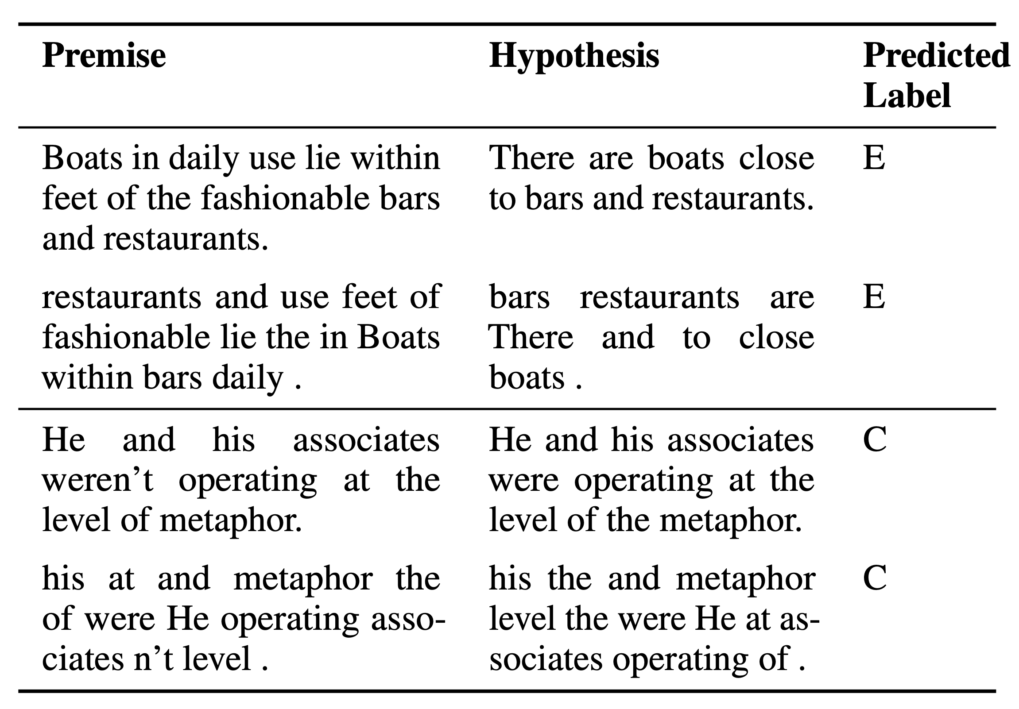

LMs Are Robust to “Unnatural Language”
Part 1: Ethology - Topic 1: Syntax
Task: natural language inference
determining if “premise” sentence can infer the “hypothesis” sentence
normally ordered text
robust answer
texts with shuffled words
Sinha, Koustuv, et al. "UnNatural Language Inference." Proceedings of the 59th Annual Meeting of the Association for Computational Linguistics and the 11th International Joint Conference on Natural Language Processing (Volume 1: Long Papers). 2021.

Slide 13
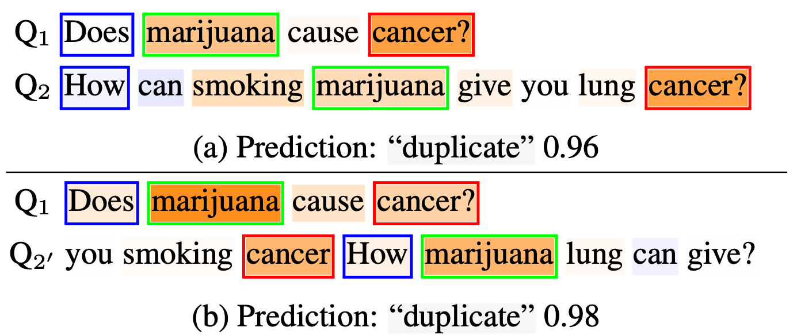
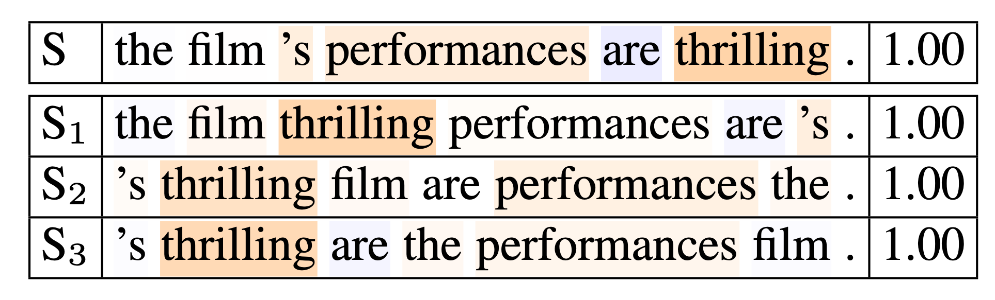
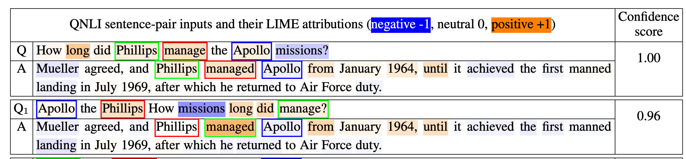
LMs Are Robust to “Unnatural Language”
Part 1: Ethology - Topic 1: Syntax
Task: paraphrase if two sentences are duplicate
Task: sentiment classification if the sentiment is positive or negative
Task: entailment if the sentence A contains the answer to question Q
Pham, Thang, et al. "Out of Order: How important is the sequential order of words in a sentence in Natural Language Understanding tasks?." Findings of the Association for Computational Linguistics: ACL-IJCNLP 2021. 2021.

Slide 14
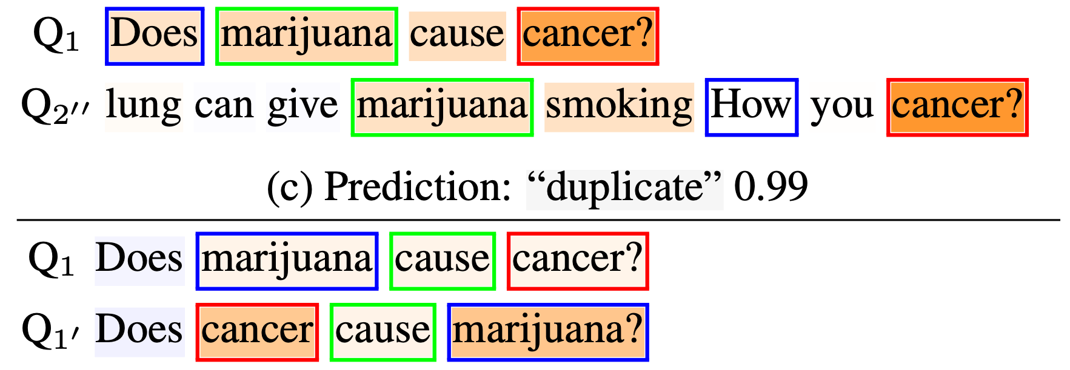
LMs Are Robust to “Unnatural Language”
Part 1: Ethology - Topic 1: Syntax
Different capabilities have different sensitivity to syntax corruption
in sentence acceptability, naturally requires integrate syntax
or when the meaning is reversed (A cause B v.s. B cause A)
Pham, Thang, et al. "Out of Order: How important is the sequential order of words in a sentence in Natural Language Understanding tasks?." Findings of the Association for Computational Linguistics: ACL-IJCNLP 2021. 2021.
Huang, Kuan-Jung, and Adrian Staub. "The transposed-word effect does not require parallel word processing: Failure to notice transpositions with serial presentation of words." Psychonomic bulletin & review 30.1 (2023): 393-400.
Mirault, Jonathan, Joshua Snell, and Jonathan Grainger. "You that read wrong again! A transposed-word effect in grammaticality judgments." Psychological Science 29.12 (2018): 1922-1929.

Slide 15
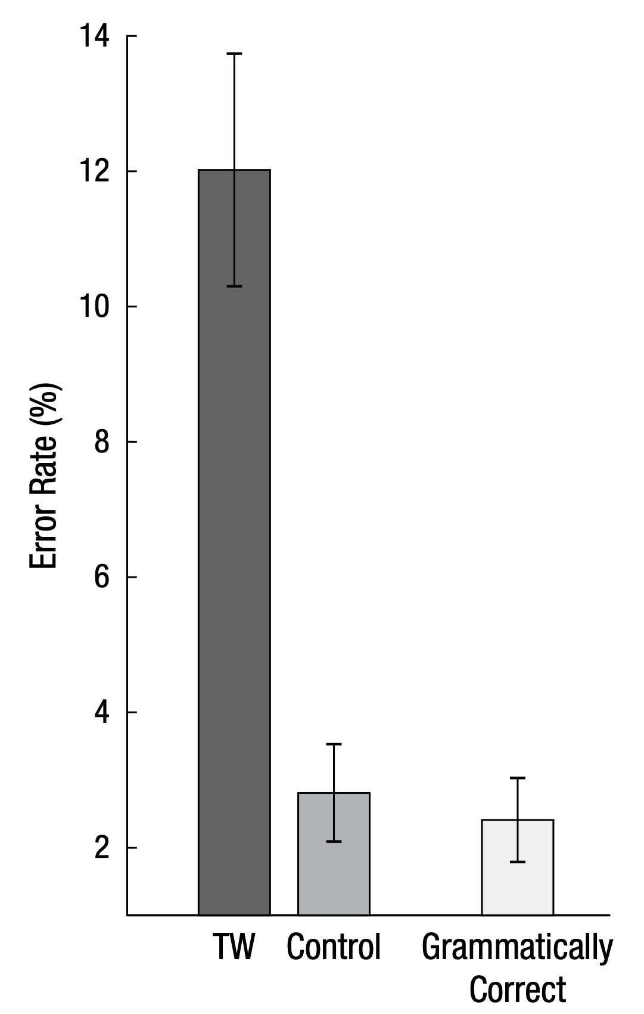
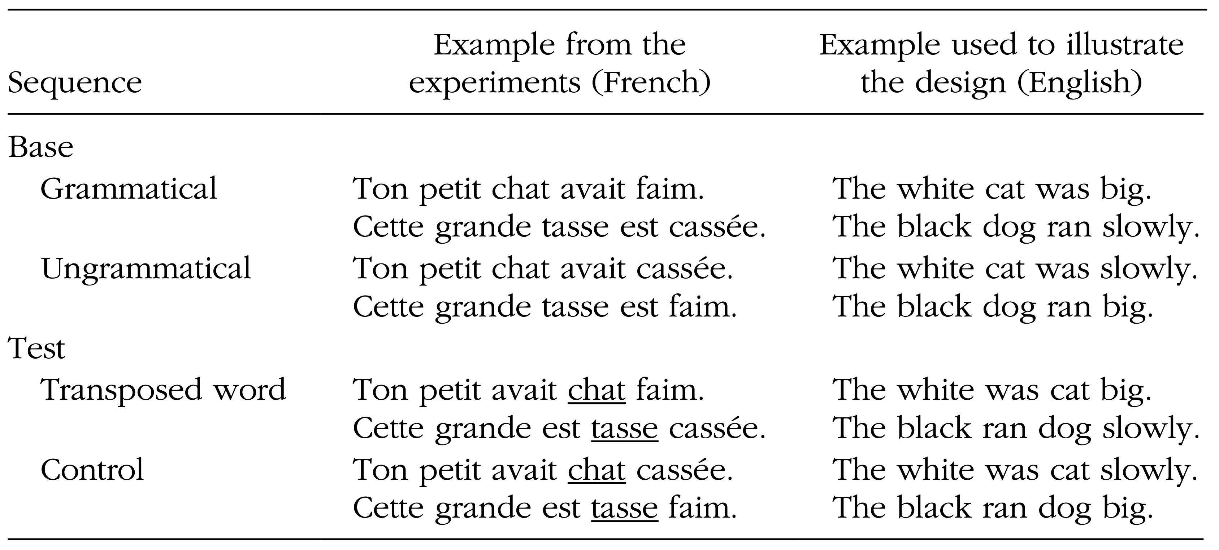


Word Transposition Effect in Humans
Part 1: Ethology - Topic 1: Syntax
Task: is the new sentence grammatically correct?
Task: tell if the sentence is grammatical or not
Observation: if the sentence is word-transposed from original sentence, it is less recognizable (high error)
Mirault, Jonathan, Joshua Snell, and Jonathan Grainger. "You that read wrong again! A transposed-word effect in grammaticality judgments." Psychological Science 29.12 (2018): 1922-1929.

Slide 16
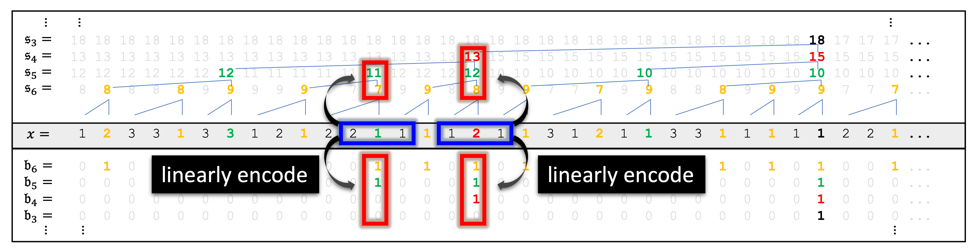
Hidden Features Encode Local Syntax
Part 1: Ethology - Topic 1: Syntax
Probing: predicting each word’s syntax within hidden features
Allen-Zhu, Zeyuan, and Yuanzhi Li. "Physics of language models: Part 1, context-free grammar." arXiv preprint arXiv:2305.13673 (2023).

Slide 17
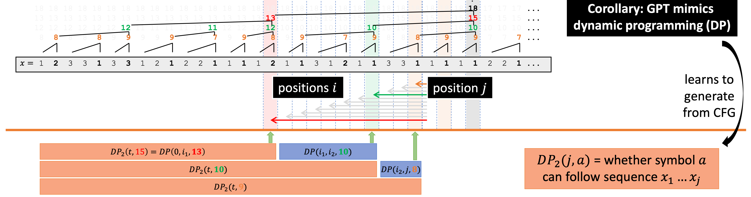
Hidden Features Encode Syntax-Parsing Features
Part 1: Ethology - Topic 1: Syntax
Probing: if hidden features can recover computational features useful for paring syntax
Allen-Zhu, Zeyuan, and Yuanzhi Li. "Physics of language models: Part 1, context-free grammar." arXiv preprint arXiv:2305.13673 (2023).

Slide 18
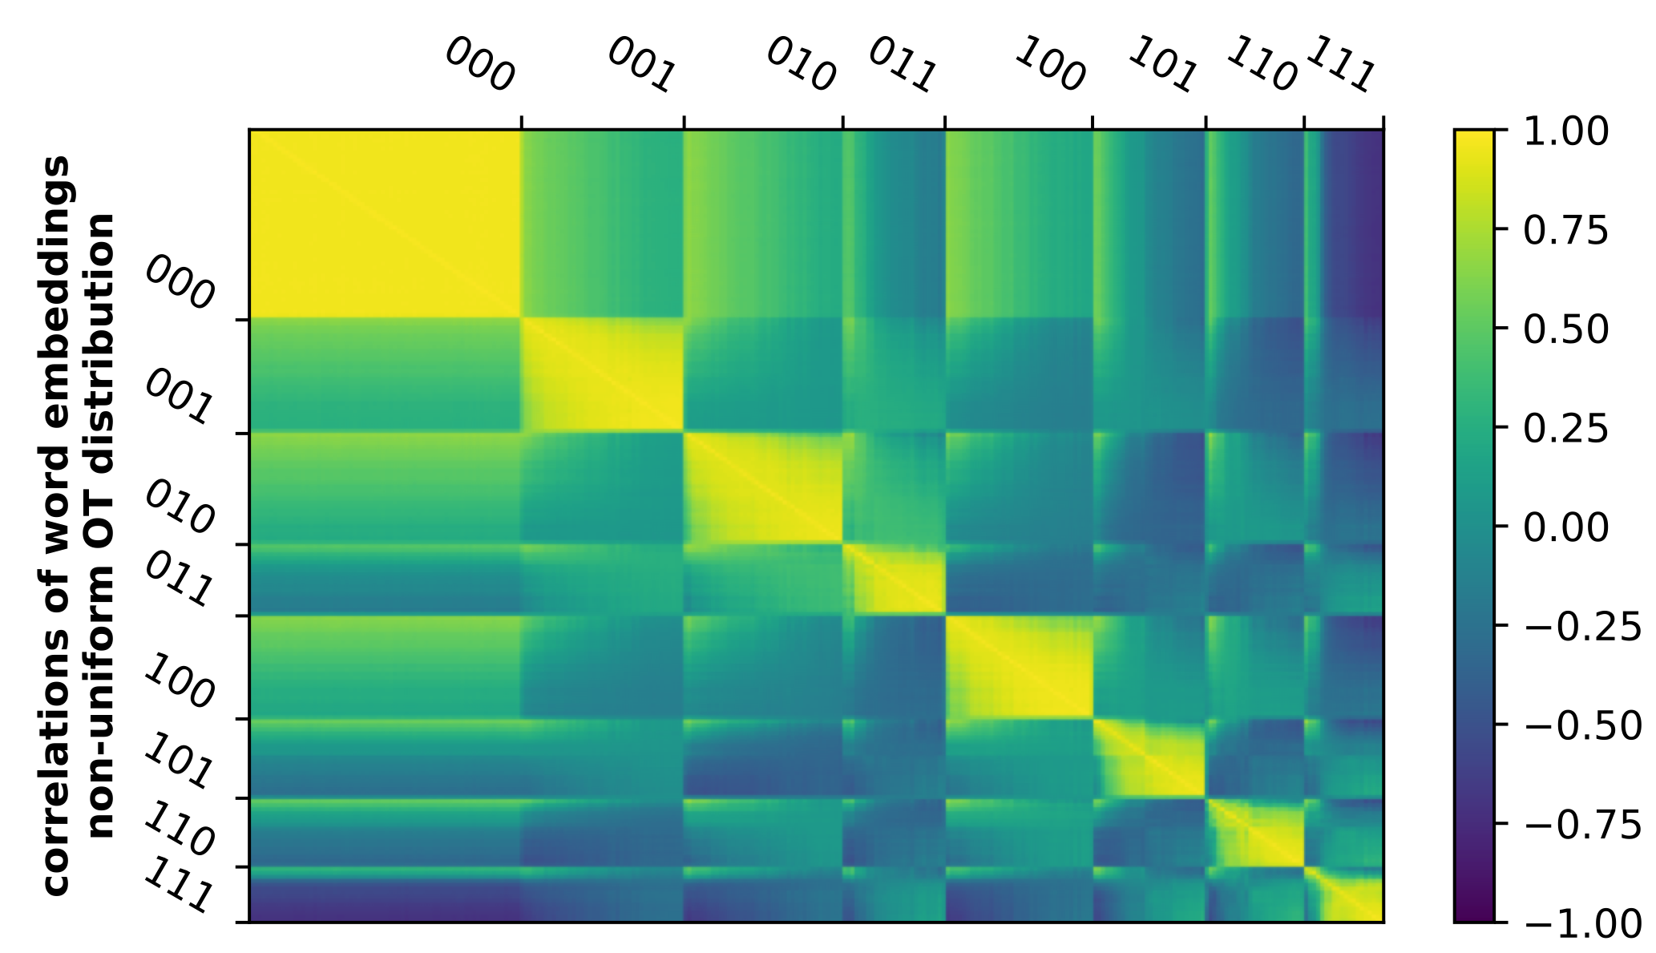
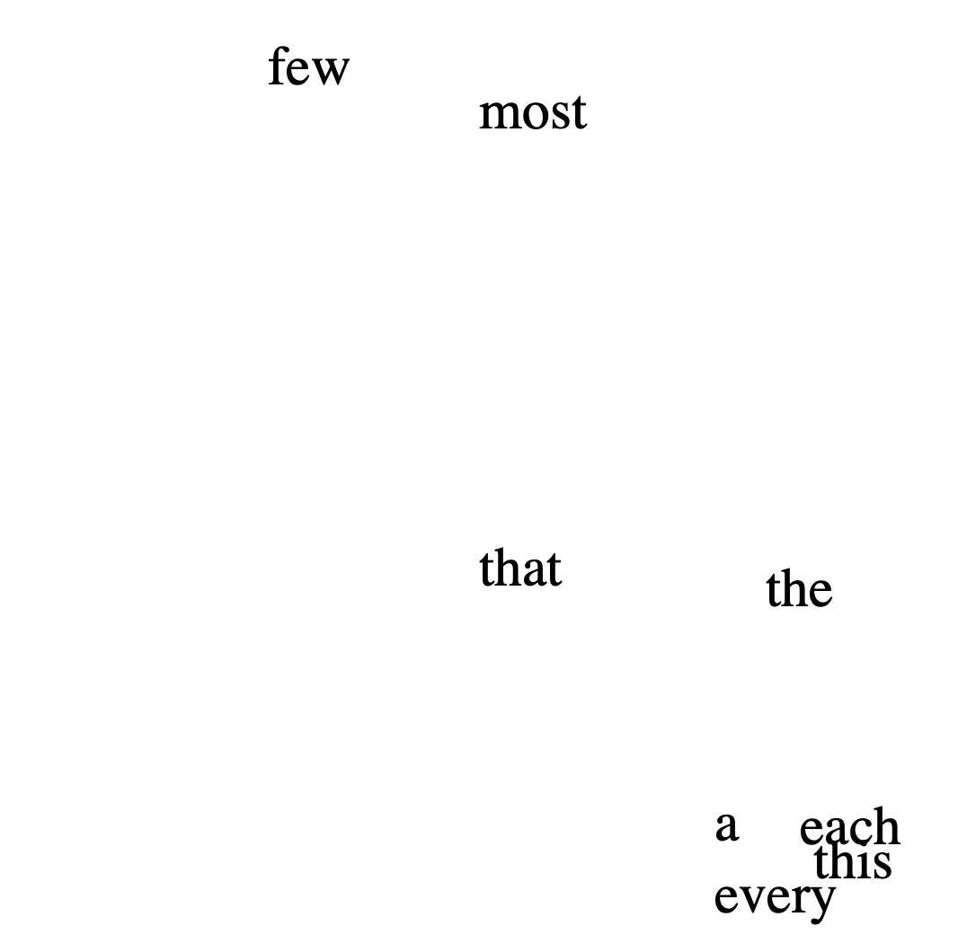
Word Embeddings Encode Syntactic Roles
Part 1: Ethology - Topic 1: Syntax
In a synthetic language, word embeddings are grouped by syntactic roles
In natural language, word embeddings reflect a reflect their syntax roles
Allen-Zhu, Zeyuan, and Yuanzhi Li. "Physics of language models: Part 1, context-free grammar." arXiv preprint arXiv:2305.13673 (2023).
Andreas, Jacob, and Dan Klein. "How much do word embeddings encode about syntax?." Proceedings of the 52nd Annual Meeting of the Association for Computational Linguistics (Volume 2: Short Papers). 2014.

Slide 19
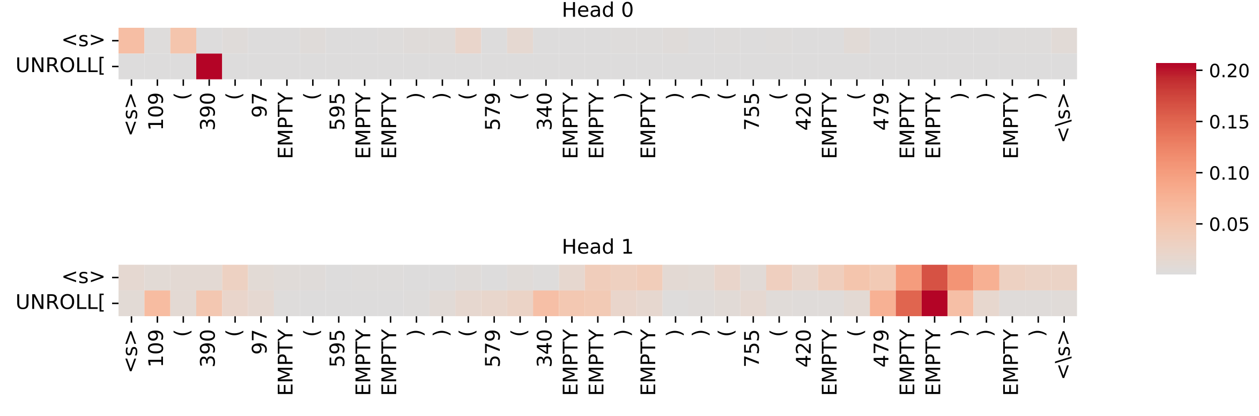
LMs Uses Attention to Utilize Syntax
Part 1: Ethology - Topic 1: Syntax
Attention heads that close parentheses
Elhage, Nelson, et al. "A mathematical framework for transformer circuits." Transformer Circuits Thread 1.1 (2021): 12.
Wang, Kevin Ro, et al. "Interpretability in the Wild: a Circuit for Indirect Object Identification in GPT-2 Small." The Eleventh International Conference on Learning Representations.
Zhang, Shizhuo Dylan, et al. "Can transformers learn to solve problems recursively?." arXiv preprint arXiv:2305.14699 (2023).

Slide 20
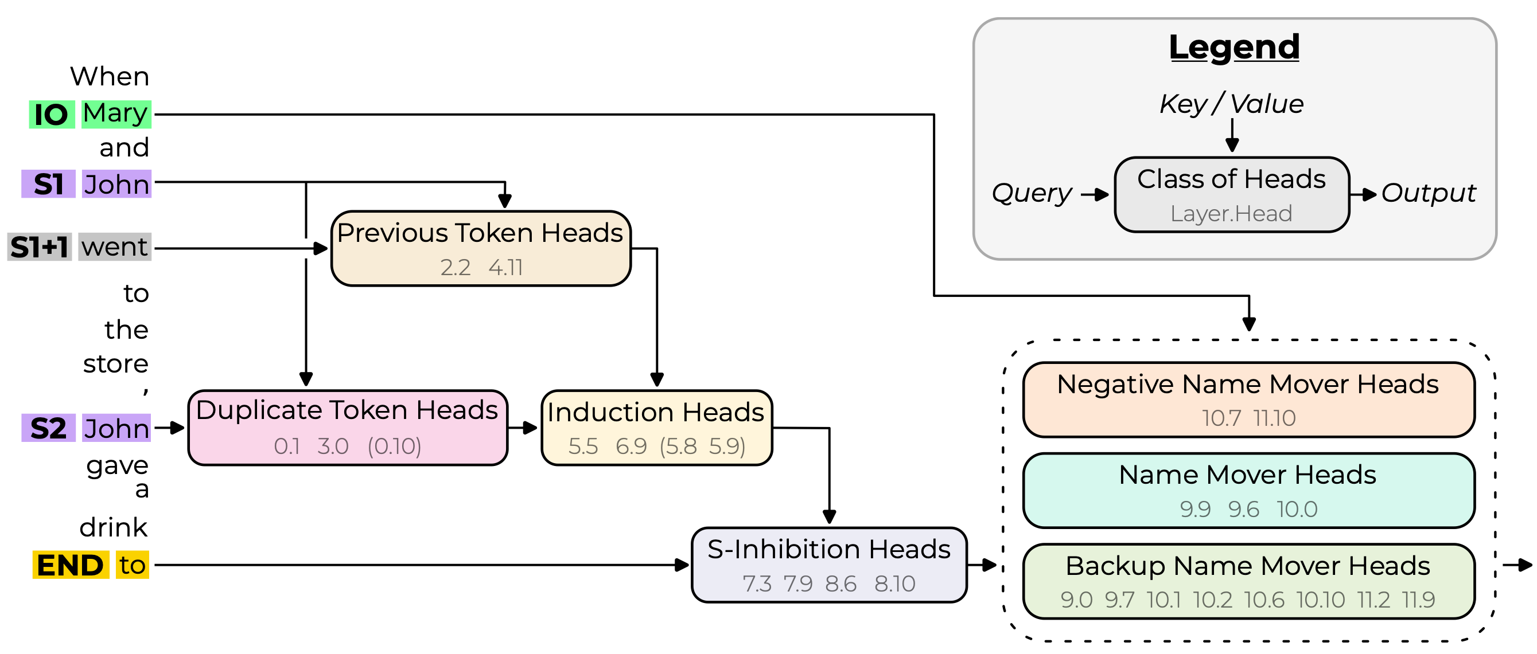
LMs Uses Attention to Utilize Syntax
Part 1: Ethology - Topic 1: Syntax
Heads that copy-past nouns
“(Backup) Name Mover Heads”: copy-pasting nouns
“Duplicate Token Heads” and “Induction Heads”: detecting duplicate nouns
“S-Inhibition Heads”: suppresing attention on duplicate nouns
Elhage, Nelson, et al. "A mathematical framework for transformer circuits." Transformer Circuits Thread 1.1 (2021): 12.
Wang, Kevin Ro, et al. "Interpretability in the Wild: a Circuit for Indirect Object Identification in GPT-2 Small." The Eleventh International Conference on Learning Representations.
Zhang, Shizhuo Dylan, et al. "Can transformers learn to solve problems recursively?." arXiv preprint arXiv:2305.14699 (2023).
Notes:
more detailed
requirement from learning or side effect

Slide 21
Room for Future Efforts
Part 1: Ethology - Topic 1: Syntax
Future work could:
describe the processing in syntax in more details
analyze other types of linguistic structures such as semantics, sense, coreference and ambituity
investigate if the syntax is directly contributing to the functions of LMs, or encoded as a side effect from LM objective.

Slide 22
Where Is Knowledge Stored
Part 1: Ethology - Topic 2: Knowledge

Slide 23
Memory Storage in Human Brain
Part 1: Ethology - Topic 2: Knowledge
We Know Some Functions of Brain Regions
Neocortex: semantic memory (e.g., facts, commonsense knowledge)
transfer
➜
Drive Thru
Amygdala: emotional implications (e.g., fear, PTSD)
🧸➜😱
Hippocampus: episodic memory (e.g., events)
🎉🥳
image credit: https://www.brainline.org/article/how-ptsd-affects-brain

Slide 24
Can We Analogize LMs with Brains?
Part 1: Ethology - Topic 2: Knowledge
and therefore, analogize LM parameters ≈ brain neurons?
next layer
One Layer
output feature
Multi-Layer Perceptron (MLP)
Causal Self-Attention
By Bodysurfinyon - Own work, CC BY-SA 4.0, https://commons.wikimedia.org/w/index.php?curid=125106144
past tokens
last token
last layer
One Transformer LM
Brain and its 6-layers in neocortex

Slide 25



Common Hypothesis: MLP $≈$ Knowledge dict
Part 1: Ethology - Topic 2: Knowledge
output feature $h_{output}$
down-projection weight $≈$ knowledge value
non-linear activation
intermediate value $≈$ knowledge neuron
intermediate feature $h_{middle}$
up-projection weight $≈$ knowledge lookup key
input feature $h_{in}$
Geva, Mor, et al. "Transformer Feed-Forward Layers Are Key-Value Memories." Proceedings of the 2021 Conference on Empirical Methods in Natural Language Processing. 2021. Dai, Damai, et al. "Knowledge Neurons in Pretrained Transformers." Proceedings of the 60th Annual Meeting of the Association for Computational Linguistics (Volume 1: Long Papers). 2022.

Slide 26
Evidence Supporting MLP $≈$ Knowledge dict
Part 1: Ethology - Topic 2: Knowledge
Inserting output features can inject certain knowledge prediction
Manually activate neurons can also force certain knowledge prediction
e.g. Dublin is the capital and largest city of England $→$ Ireland
Certain neurons react to knowledge types
e.g., “part-of” types, related to TV shows
[1] Geva, Mor, et al. "Transformer Feed-Forward Layers Are Key-Value Memories." Proceedings of the 2021 Conference on Empirical Methods in Natural Language Processing. 2021. [2] Dai, Damai, et al. "Knowledge Neurons in Pretrained Transformers." Proceedings of the 60th Annual Meeting of the Association for Computational Linguistics. 2022.
[3] Meng, Kevin, et al. "Locating and editing factual associations in GPT." Advances in Neural Information Processing Systems 35 (2022): 17359-17372.
[4] Meng, Kevin, et al. "Mass-Editing Memory in a Transformer." The Eleventh International Conference on Learning Representations.

Slide 27


Knowledge Seems to Be Stored Messily
Part 1: Ethology - Topic 2: Knowledge
Expectation: semantic / logical related facts should share parameters
Why? intuitively, this leads to better semantic/logic-based generalization:
if $x→y$, when $P(x)↑$, the LM can automatically $P(y)↑$
LM Parameters
“Jordan speaks English”
“speaks-English” neurons
Jordan’s representation
“is-American” neurons
“Jordan is American”

Slide 28
Knowledge Seems to Be Stored Messily
Part 1: Ethology - Topic 2: Knowledge
incompatible sentences postively align parameters
Negation curse:
X: Leonardo is from USA
not X: Leonardo is not from USA
Over-Ripple:
X: Leonardo is from USA
$χ$: Leonardo speaks USA
Qin, Jiaxin, et al. "Why Does New Knowledge Create Messy Ripple Effects in LLMs?." Proceedings of the 2024 Conference on Empirical Methods in Natural Language Processing. 2024.

Slide 29
Knowledge Seems to Be Stored Messily
Part 1: Ethology - Topic 2: Knowledge
similar sentences with low parameter overlap
Cross-Lingual Barrier:
Leonardo is from USA
莱昂纳多来自美国 (same meaning)
Logical Distance Barrier:
Leonardo is from USA
The highest building in the capital of Leonardo’s homeland is Washington Monument (3 logical steps from above)
Qin, Jiaxin, et al. "Why Does New Knowledge Create Messy Ripple Effects in LLMs?." Proceedings of the 2024 Conference on Empirical Methods in Natural Language Processing. 2024.

Slide 30
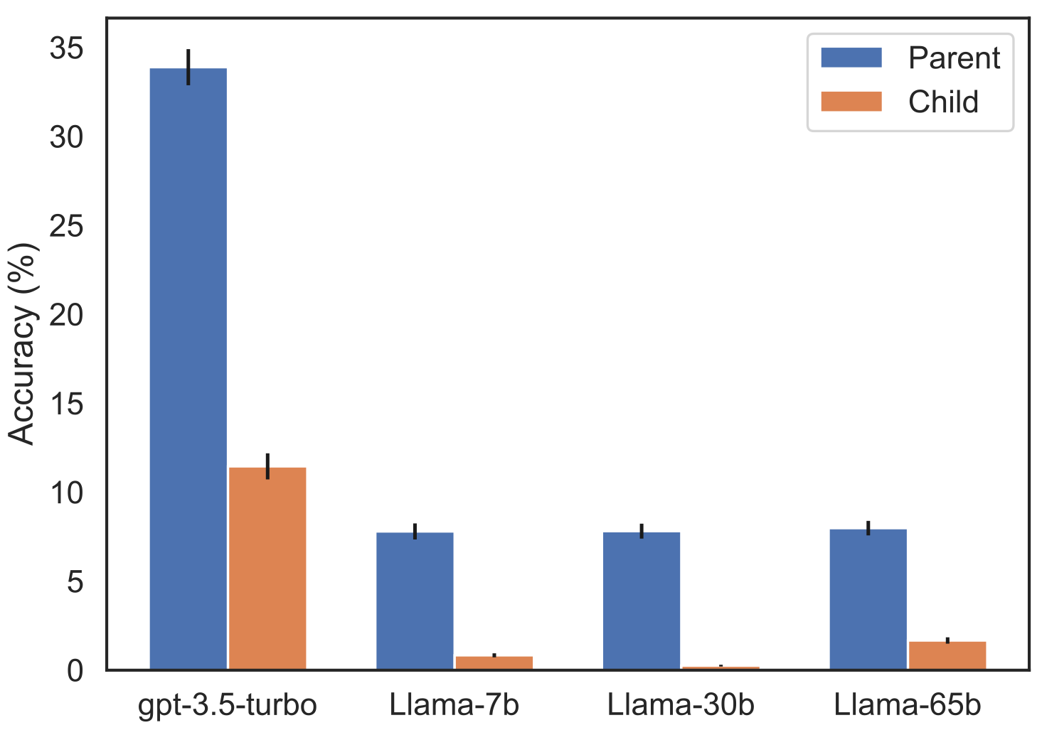
Curse of Reversals / Inverse-Searches
Part 1: Ethology - Topic 2: Knowledge
Training: After learning on data “A is B”.
✓ Forward inference: LMs can successfully answer “A is [ ? ]” $→$ “B”
✘ Inverse inference: they struggle to answer “[ ? ] is B” $→$ “A”
Q: Who is Tom Cruise’s mother? A: Mary Lee Pfeiffer
Q: Who is Mary Lee Pfeiffer’s son? A: Tom Cruise
Berglund, Lukas, et al. "The Reversal Curse: LLMs trained on “A is B” fail to learn “B is A”." The Twelfth International Conference on Learning Representations.
Allen-Zhu, Zeyuan, and Yuanzhi Li. "Physics of Language Models: Part 3.2, Knowledge Manipulation." In The Thirteenth International Conference on Learning Representations.
Notes:
specificity
editing
expression?
bias

Slide 31
Room for Future Efforts
Part 1: Ethology - Topic 2: Knowledge
Investigating if more specific and precise localization of knowledge neurons is possible (or are knowledge neurons distributed in nature)
Revealing the relation between knowledge neuron localization and knowledge editing.
Looking at the relation between knowledge and their semantically equivalent expressions in LM processing
Investigating other LM components’ roles in knowledge processing & storage

Slide 32
How Is Reasoning Conducted within LM
Part 1: Ethology - Topic 3: Reasoning

Slide 33
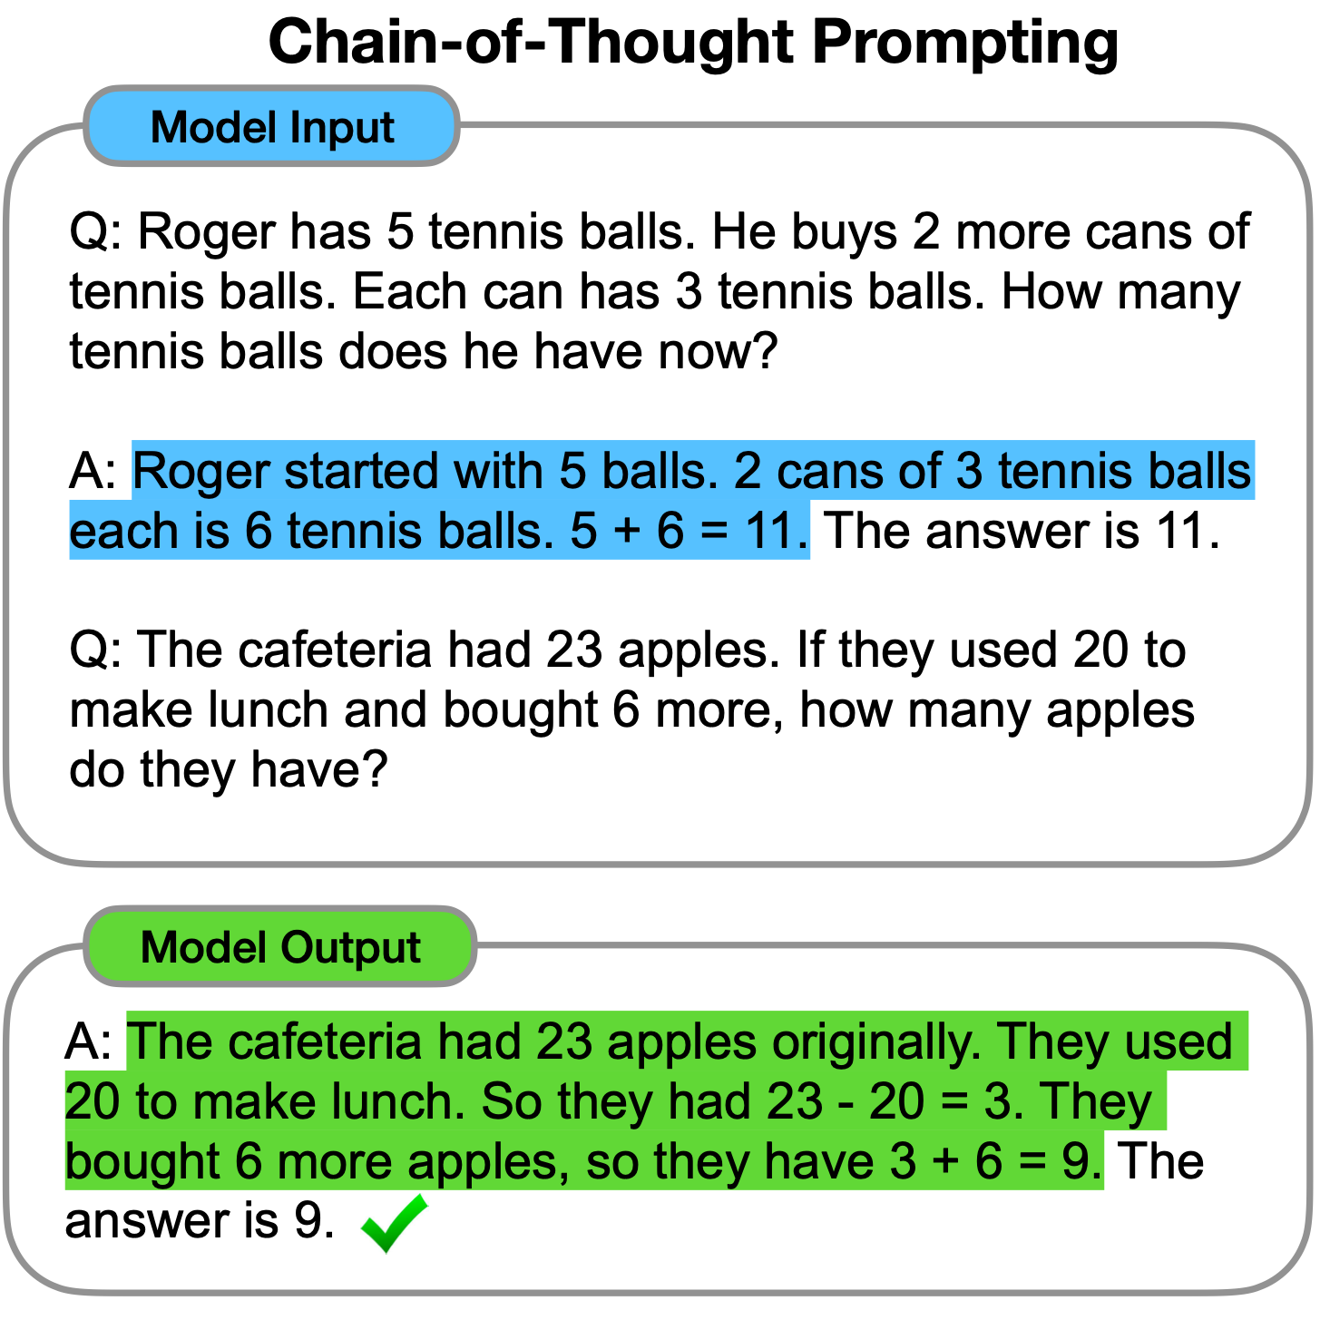
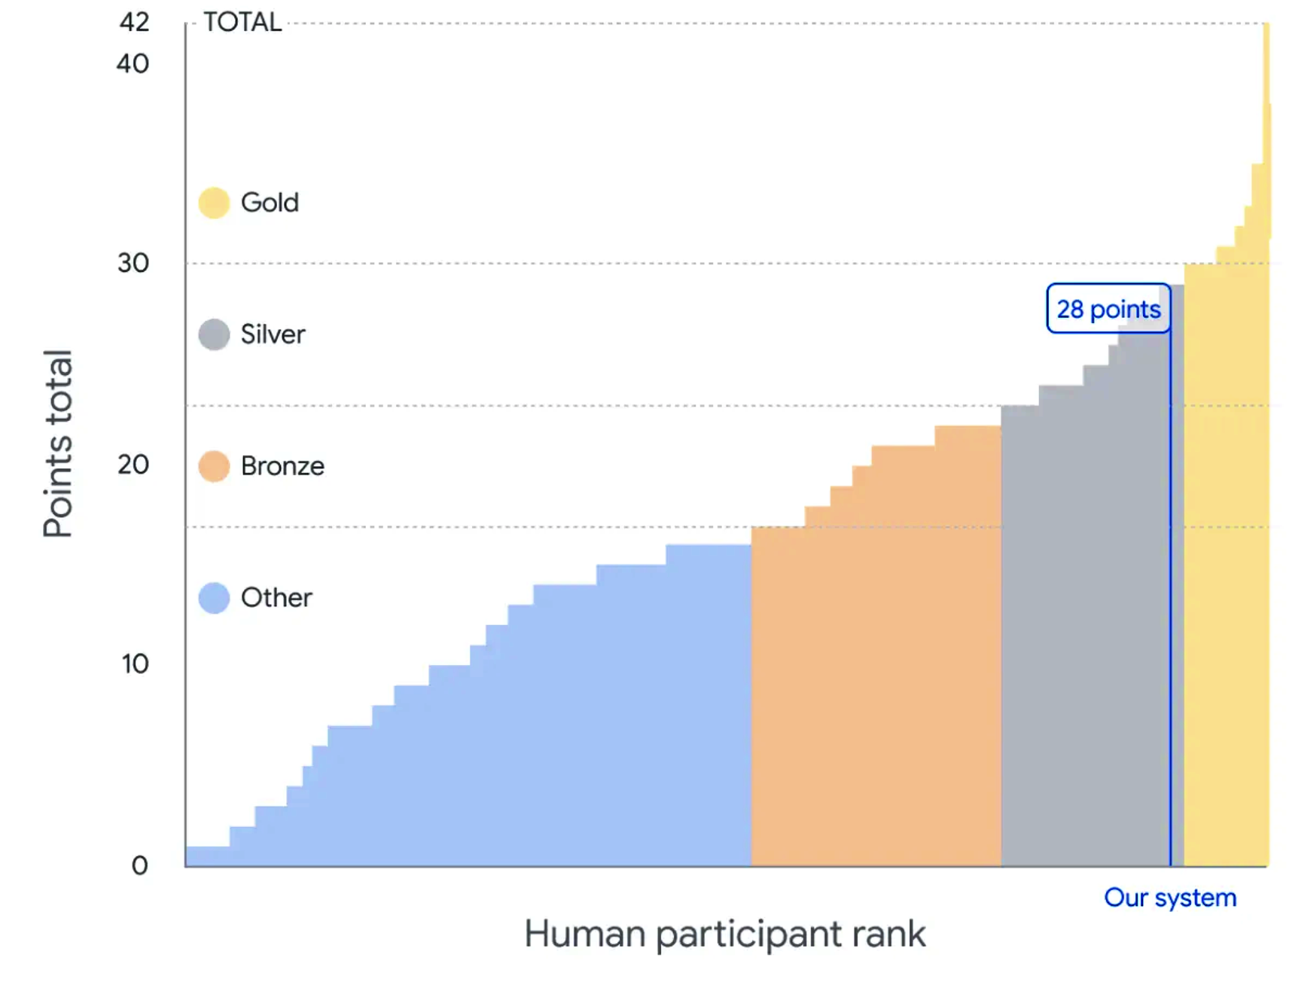
LMs’ Reasoning Ability
Part 1: Ethology - Topic 3: Reasoning
AlphaGeometry excel at olympiad-level math problems
chain-of-thought reasoning by LMs
Trinh, Trieu H., et al. "Solving olympiad geometry without human demonstrations." Nature 625.7995 (2024): 476-482.
Wei, Jason, et al. "Chain-of-thought prompting elicits reasoning in large language models." Advances in neural information processing systems 35 (2022): 24824-24837.

Slide 34
LMs Reasoning Is Sensitive to Perturbations
Part 1: Ethology - Topic 3: Reasoning
https://community.openai.com/t/why-9-11-is-larger-than-9-9-incredible/869824

Slide 35
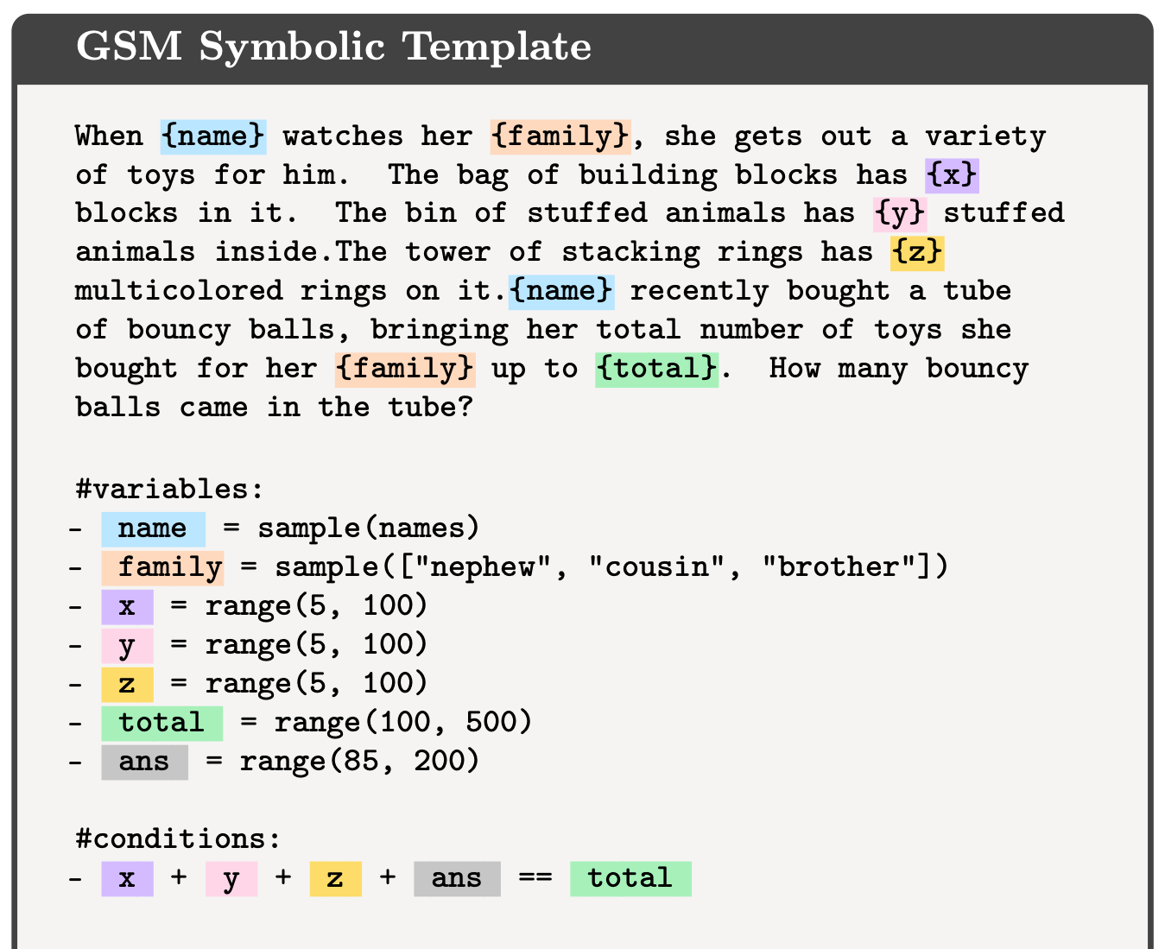
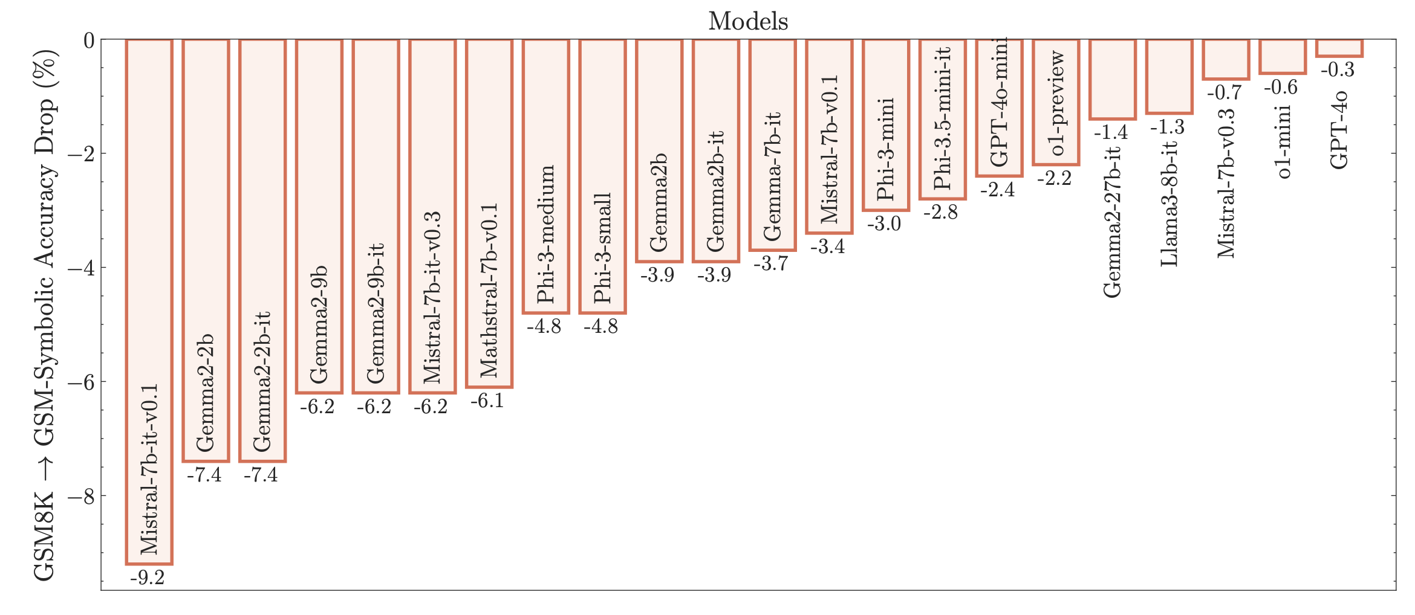
LMs Reasoning Is Sensitive to Perturbations
Part 1: Ethology - Topic 3: Reasoning
Grounding to real life matters
After replacing familiar nouns (e.g., “uncle,” “nephew”) with symbols, language models exhibit performance declines.
Mirzadeh, Seyed Iman, et al. "GSM-Symbolic: Understanding the Limitations of Mathematical Reasoning in Large Language Models." The Thirteenth International Conference on Learning Representations.

Slide 36
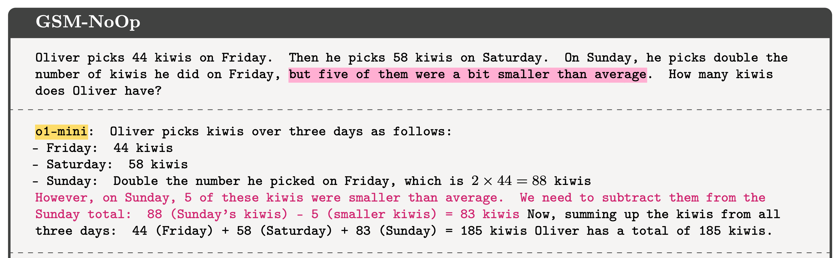
Logical Reasoning and Semantic Reasoning Entangles
Part 1: Ethology - Topic 3: Reasoning
when “grounding to real life” poses biases to reasoning
After adding semantically related but logically irrelevant statements, LM fail to ignore them but wrongly combine them and make mistakes.
Mirzadeh, Seyed Iman, et al. "GSM-Symbolic: Understanding the Limitations of Mathematical Reasoning in Large Language Models." The Thirteenth International Conference on Learning Representations.

Slide 37
Deeper Models Reason Better
Part 1: Ethology - Topic 3: Reasoning
accuracy drops as required reasoning length increases
accuracy rises as model is deeper
Ye, Tian, et al. "Physics of language models: Part 2.1, grade-school math and the hidden reasoning process." The Thirteenth International Conference on Learning Representations. 2024.

Slide 38
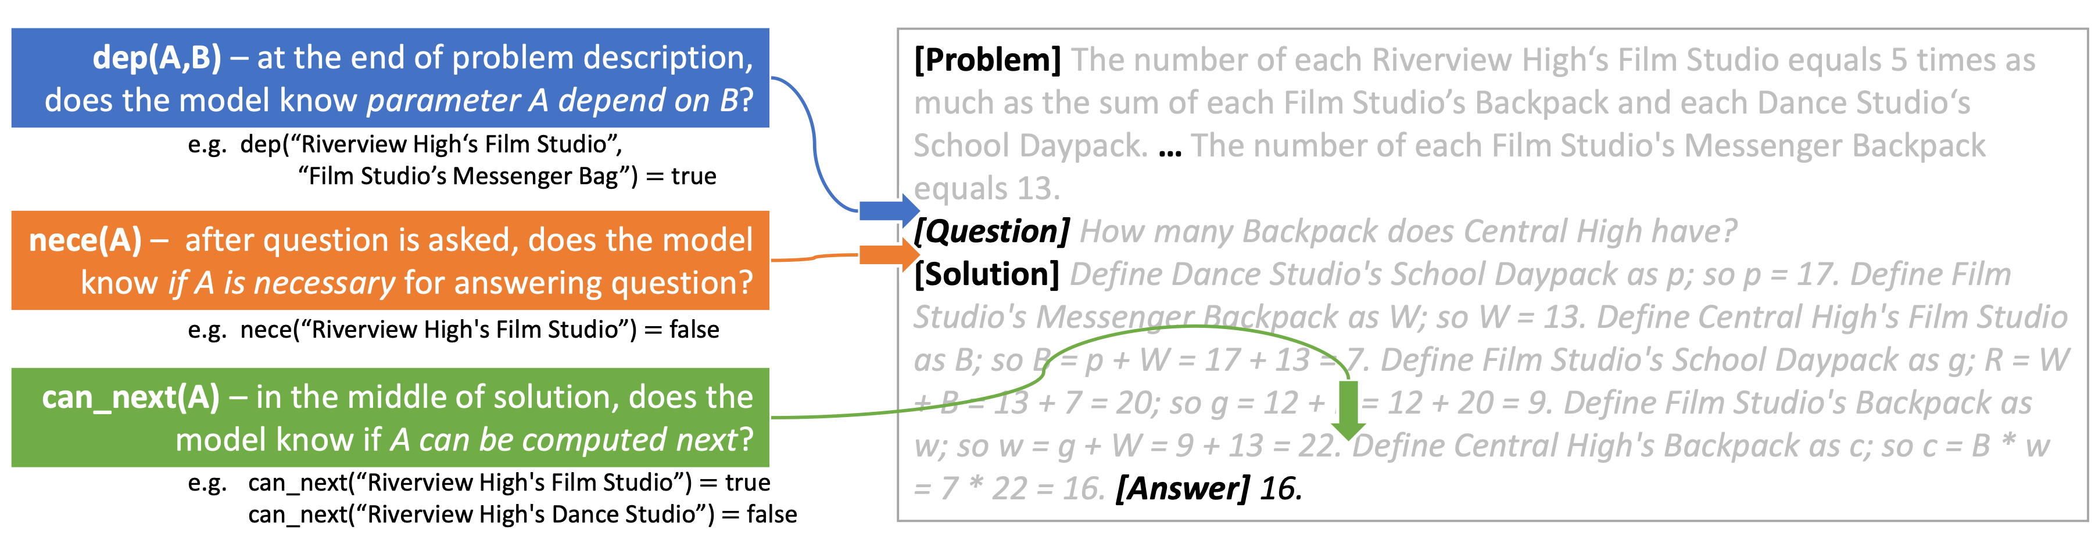
Hidden Features Encode Math Operations
Part 1: Ethology - Topic 3: Reasoning
Ye, Tian, et al. "Physics of language models: Part 2.1, grade-school math and the hidden reasoning process." The Thirteenth International Conference on Learning Representations. 2024.

Slide 39
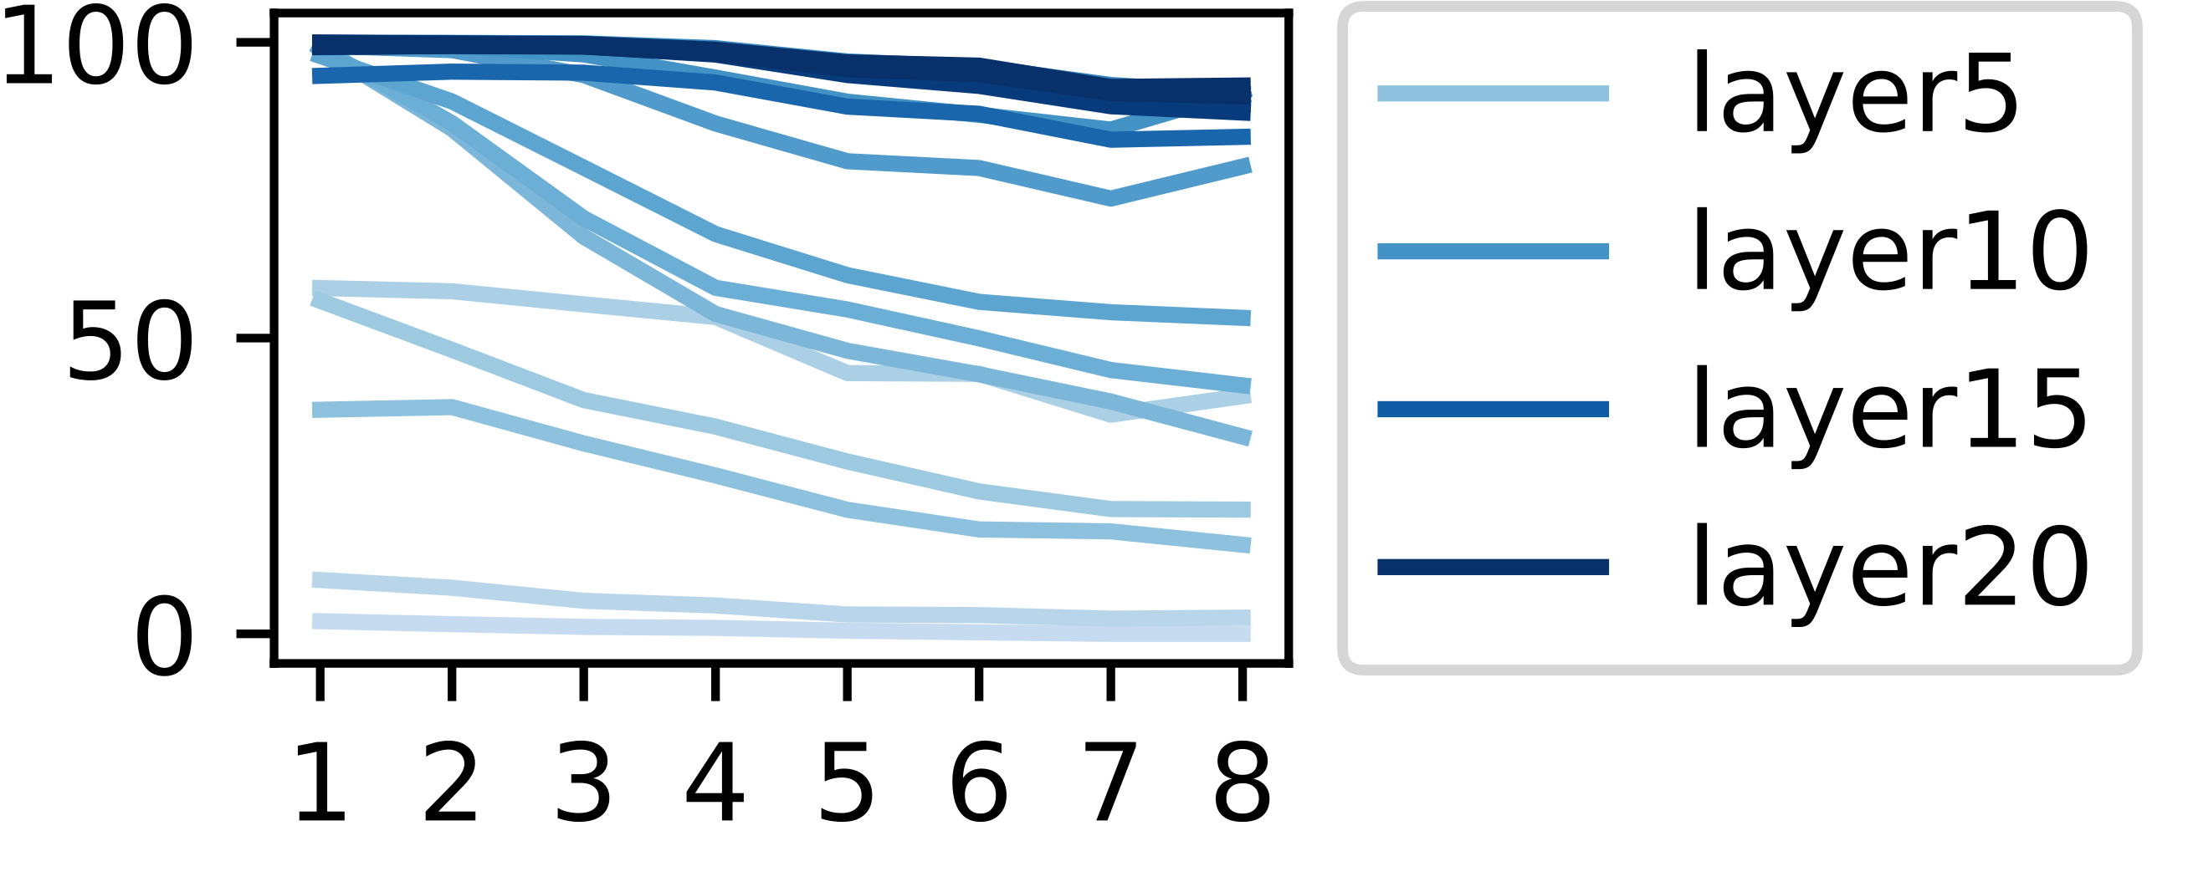
Every Math Operation Benefit from Depth
Part 1: Ethology - Topic 3: Reasoning
y-axis: $nece(X,Q)$, predicting if fact $X$ is necessary for answering question $Q$
model depth
x-axis: 2 elements’ distance
potential reason: every math operation needs certain depth of layers to stack with each other
Ye, Tian, et al. "Physics of language models: Part 2.1, grade-school math and the hidden reasoning process." The Thirteenth International Conference on Learning Representations. 2024.

Slide 40
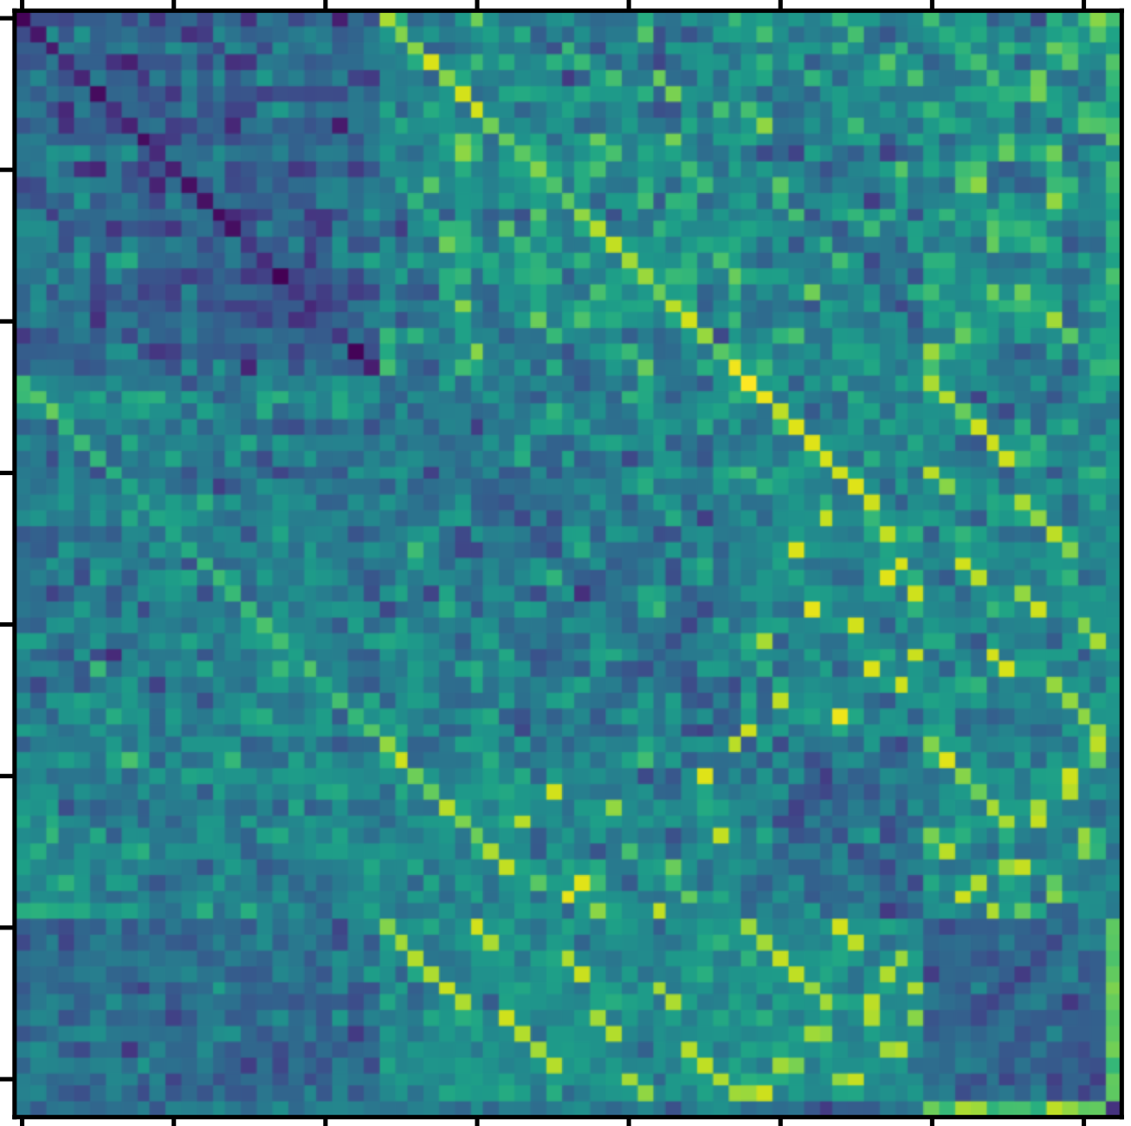
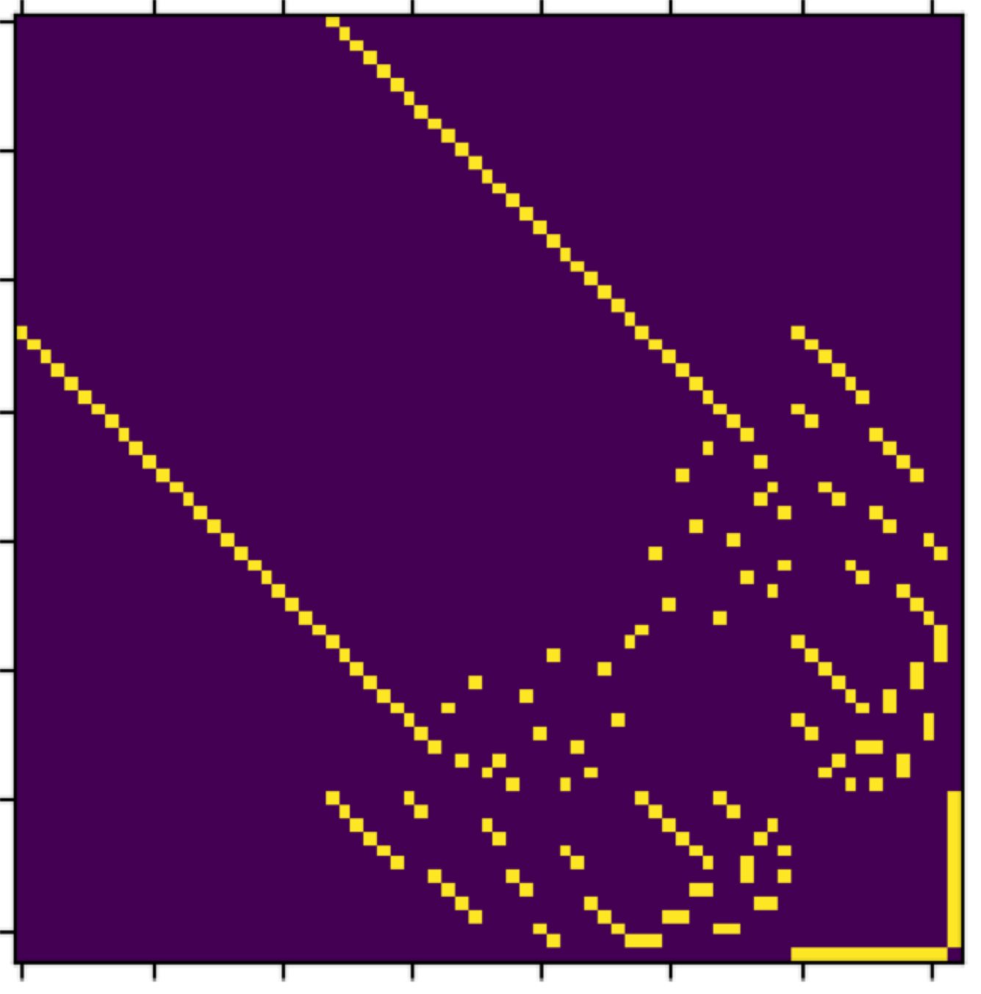
LM Encodes Reachability after Learning Planning
Part 1: Ethology - Topic 3: Reasoning
Learned FFN weight $W^{M}$ between graph nodes
ground-truth connectivity
Ye, Tian, et al. "Physics of language models: Part 2.1, grade-school math and the hidden reasoning process." The Thirteenth International Conference on Learning Representations. 2024.

Slide 41
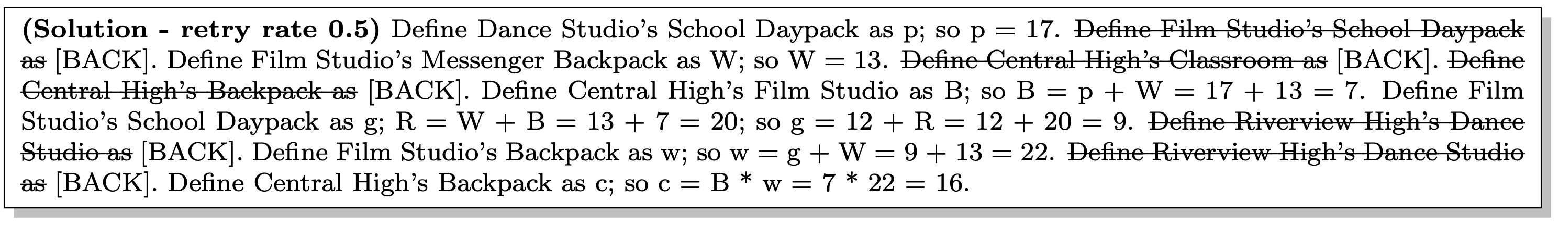
Learning on Error-Correction Data Helps
Part 1: Ethology - Topic 3: Reasoning
Example:
Trend:
Ye, Tian, et al. "Physics of language models: Part 2.1, grade-school math and the hidden reasoning process." The Thirteenth International Conference on Learning Representations. 2024.

Slide 42
How Does Error-Retry Data Benefit Reasoning?
Part 1: Ethology - Topic 3: Reasoning
After training on error-retry data
No need to mask out mistakes’ loss terms.
During inference, LLMs hardly intentionally make mistakes,
Instead, they still try their best to answer correctly in the first place.
summary: retry data is beneficial and safe.
Ye, Tian, et al. "Physics of language models: Part 2.1, grade-school math and the hidden reasoning process." The Thirteenth International Conference on Learning Representations. 2024.

Slide 43
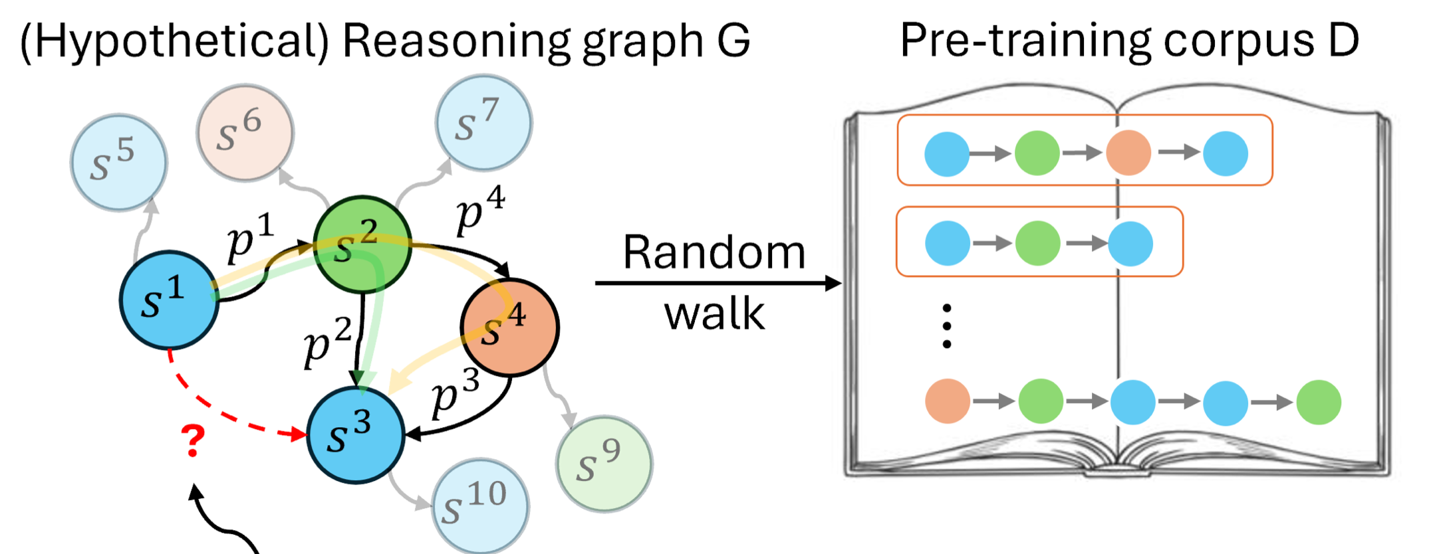
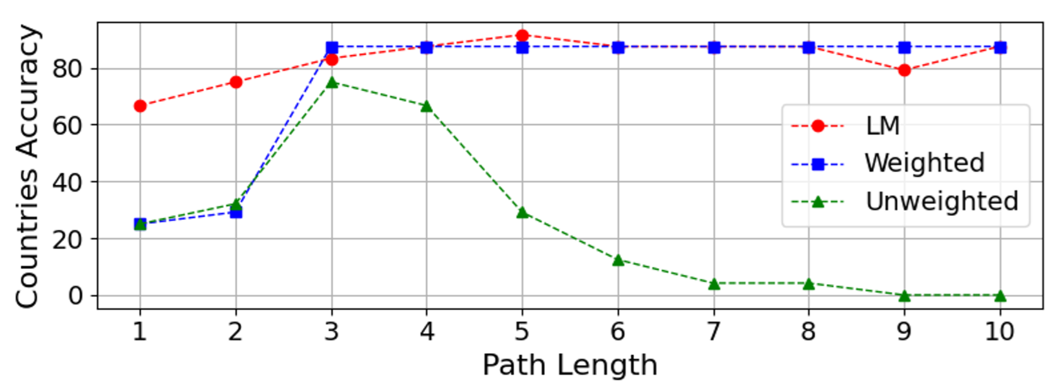
Reasoning Can Also Be Interpreted as Random Walk in Statement Space
Part 1: Ethology - Topic 3: Reasoning
Interpreting reasoning as a mixture or reasoning “walks” in claim graph $G$.
A weighted average of paths approximate reasoning acc well.
Wang, Xinyi, et al. "Understanding Reasoning Ability of Language Models From the Perspective of Reasoning Paths Aggregation." International Conference on Machine Learning. PMLR, 2024.

Slide 44
Room for Future Research
Part 1: Ethology - Topic 3: Reasoning
A more precise and systematic description of reasoning trace in LMs
Extension to other reasoning domains, e.g., reasoning involving knowledge, domain-specific reasoning, reasoning on augmented information
Revealing reasoning capacity and scaling across model size & data.

Slide 45
How Do Components Function in Language Models?
Part 2: Physiology
Topics
Attention: Attention, position and context
Embeddings: What is the function of word embeddings

Slide 46
Attention, Position and Context
Part 2: Physiology - Topic 1: Attention

Slide 47
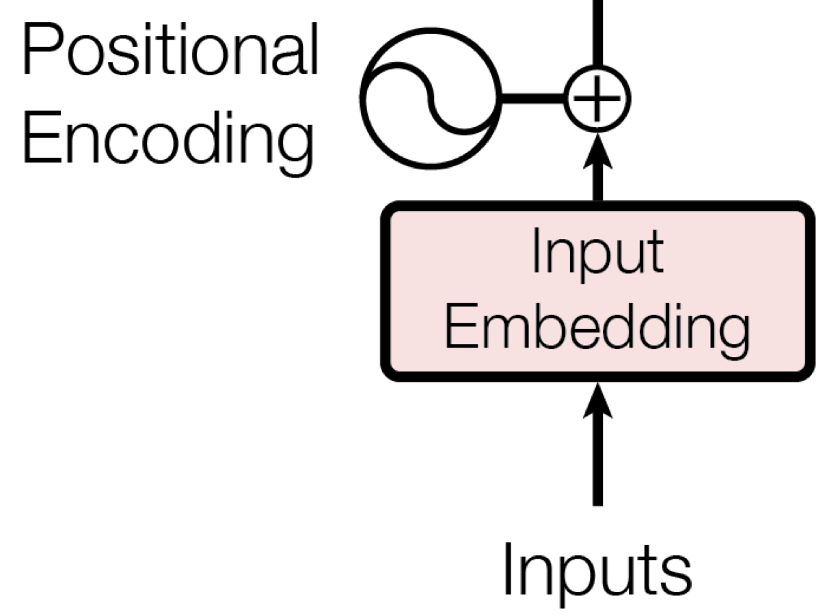
Absolute Positional Encoding: ❌
Part 2: Physiology - Topic 1: Attention
The absolute positional encoding used in vanilla Transformers is not generalizable to unseen lengths.
???
Unseen positions
https://erdem.pl/2021/05/understanding-positional-encoding-in-transformers

Slide 48
Relative Positional Encoding: ❓
Part 2: Physiology - Topic 1: Attention
Relative positional encoding was proposed in the hope to alleviate this problem
Core idea: determining attention based on distance
$$x=($$
$$x_{1},$$
$$x_{2},$$
$$x_{3},$$
$$x_{4},$$
… …
$$x_{d-1},$$
$$x_{d})$$
… …
RoPE:
$$l_{i,j}=\text{rot}(q_{i})^{⊤}\text{rot}(k_{j})$$
only depends on $i-j$, regardless of $i$ or $j$.
(Used in LLaMA, Llama-2, GPT-J, etc.)
$$\text{rot}(x)$$
…
Su, Jianlin, et al. "Roformer: Enhanced transformer with rotary position embedding." arXiv preprint arXiv:2104.09864 (2021).

Slide 49
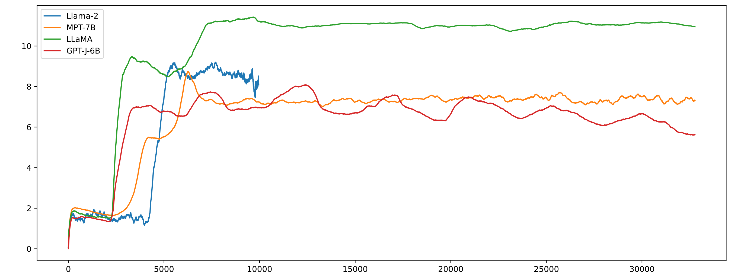
Relative Positional Encoding: ❓
Part 2: Physiology - Topic 1: Attention
However, current LLMs still struggle on unseen lengths.
Negative Log-Likelihood (NLL, also =$log$(perplexity)) $↓$
High perplexity, bad fluency
Low perplexity, good fluency
length

Slide 50
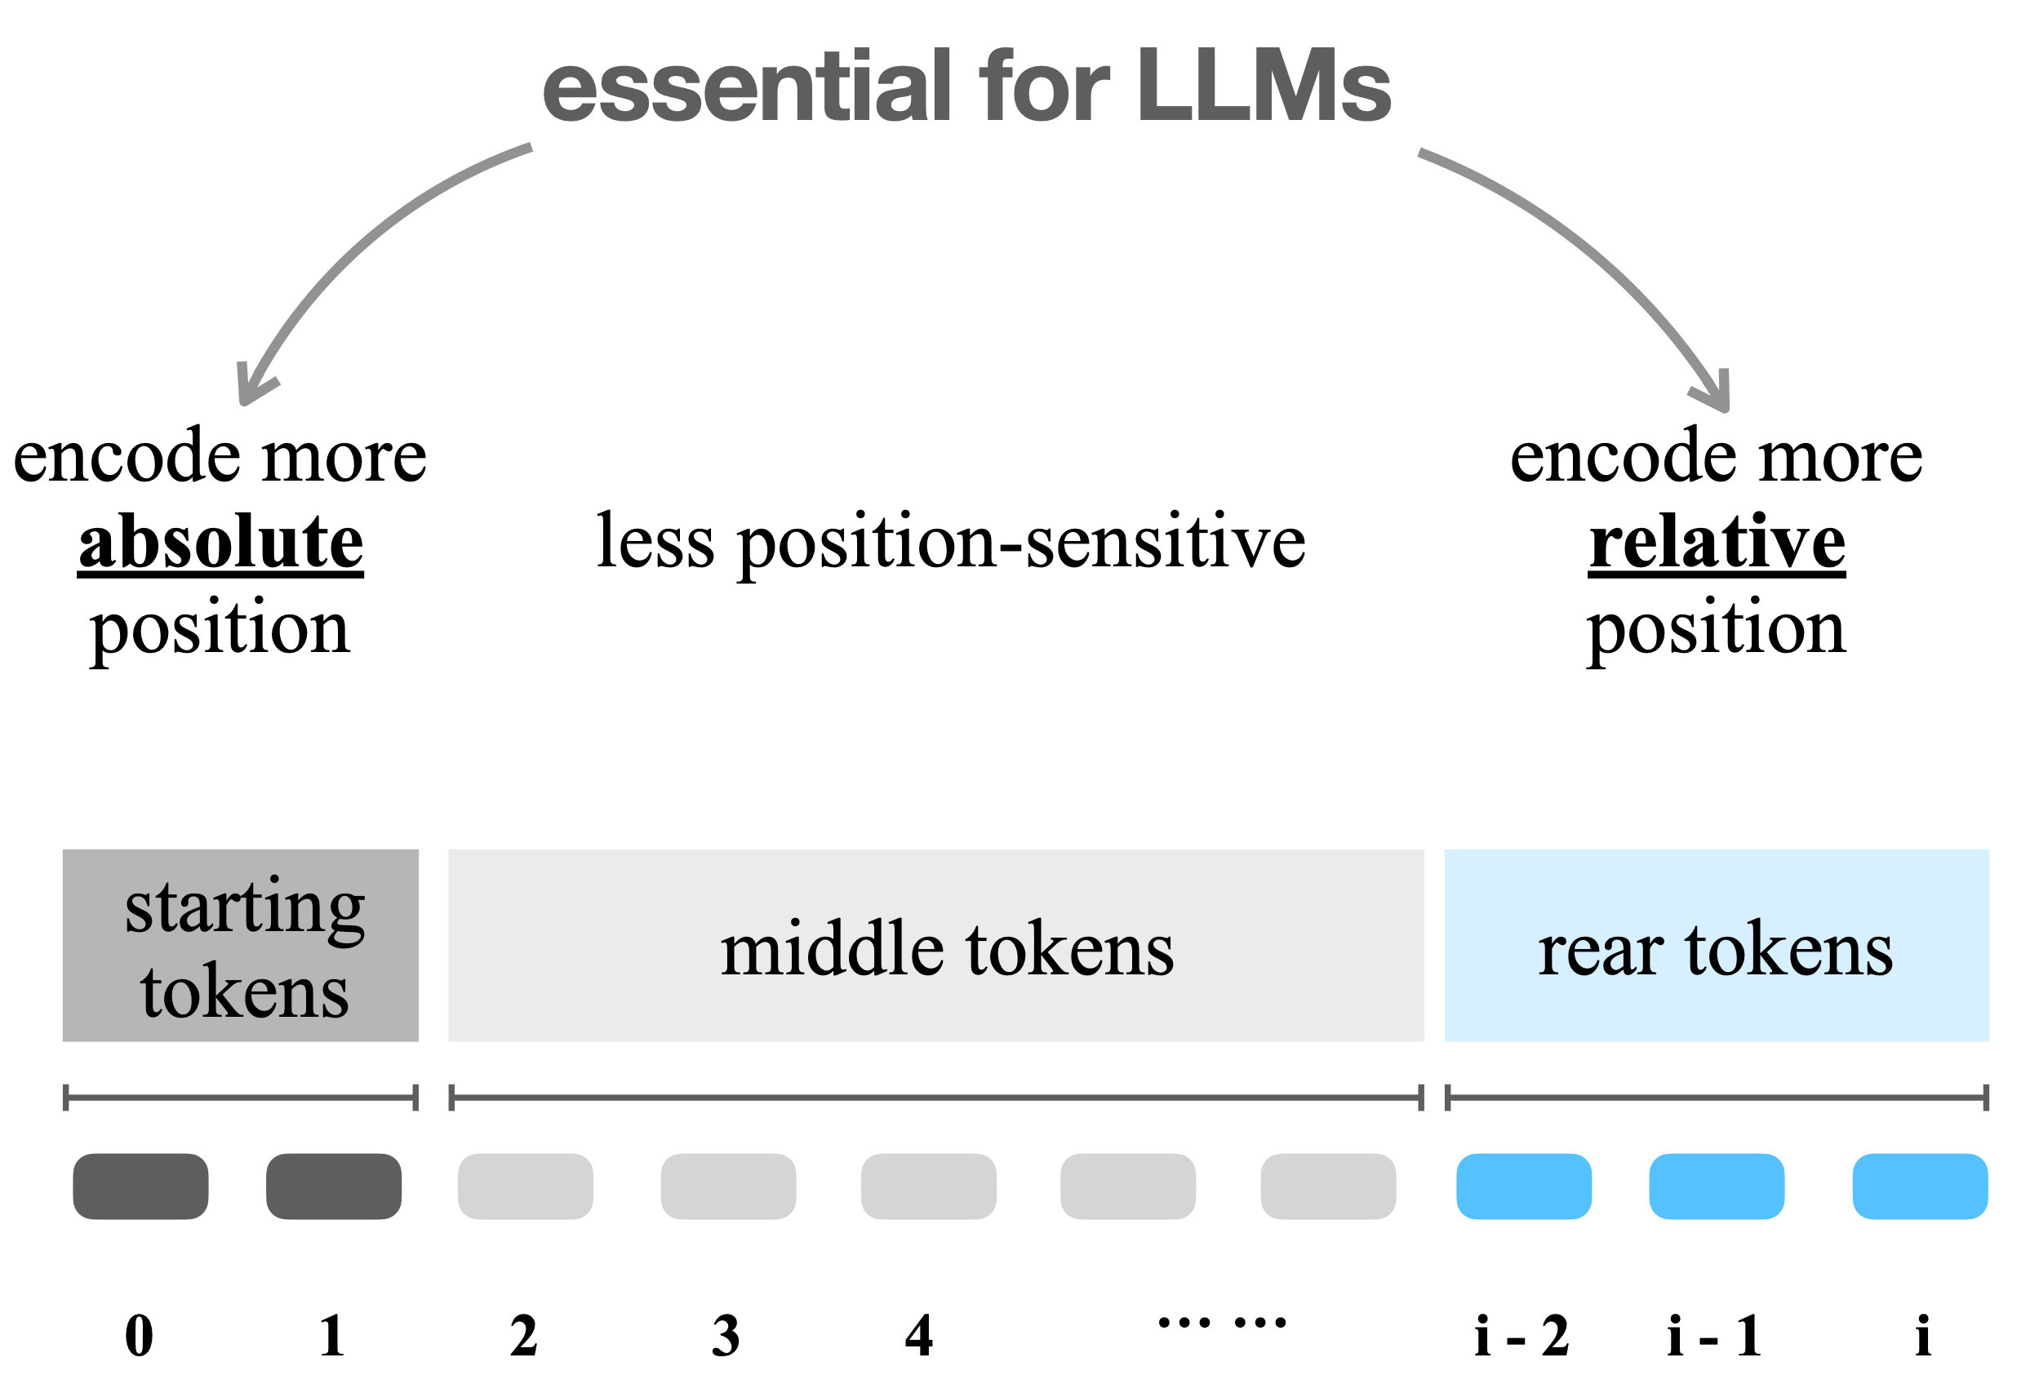
A Conceptual Model of Relative Position Encoding
Part 2: Physiology - Topic 1: Attention
Han, Chi, et al. "LM-Infinite: Zero-Shot Extreme Length Generalization for Large Language Models." Proceedings of the 2024 Conference of the North American Chapter of the Association for Computational Linguistics: Human Language Technologies (Volume 1: Long Papers). 2024. (Outstanding Paper Award)

Slide 51
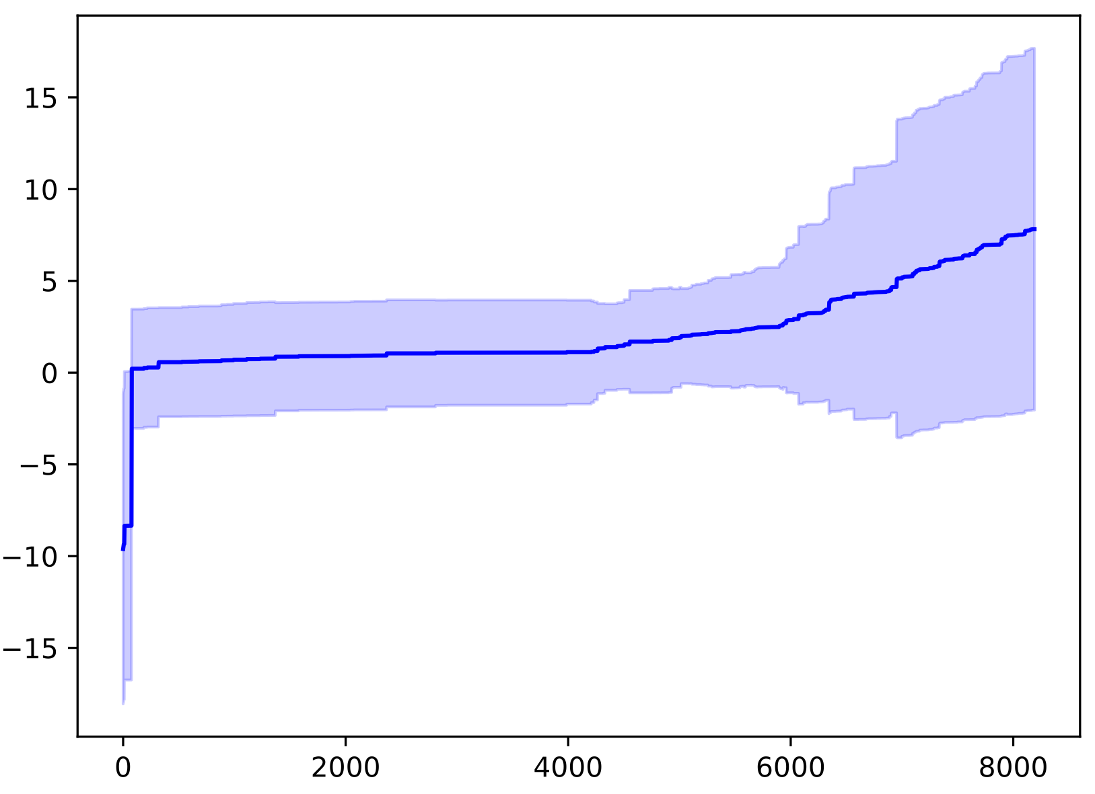
Factor 1: Unseen Distance
Part 2: Physiology - Topic 1: Attention
Theorem 1 (Informal): For an attention mechanism using relative positional encoding, the attention logits must explode to infinities to differentiate previously unseen distances apart as the sequence length increases.
Max. Logit in Sequence
pre-training length bound = 4096
The attention logits in Llama-2 explode as length exceeds the pre-training limit.
length
Han, Chi, et al. "LM-Infinite: Zero-Shot Extreme Length Generalization for Large Language Models." Proceedings of the 2024 Conference of the North American Chapter of the Association for Computational Linguistics: Human Language Technologies (Volume 1: Long Papers). 2024. (Outstanding Paper Award)

Slide 52
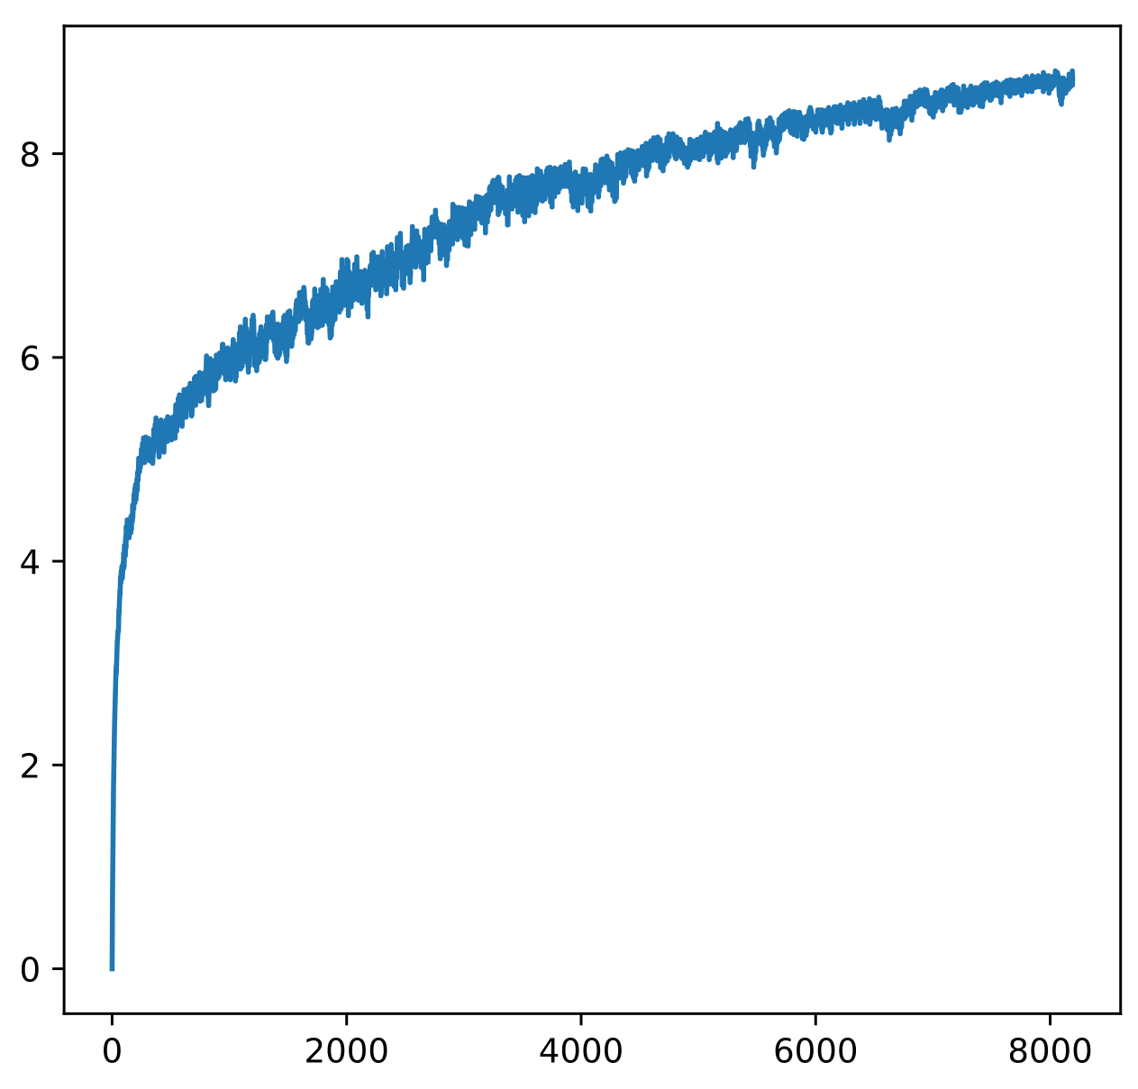
Factor 2: Too many tokens
Part 2: Physiology - Topic 1: Attention
Longer texts require attention on more tokens.
Theorem 2 (informal): If the attention logits are bounded, as the sequence becomes longer, the attention entropy grows to infinity.
Attention Entropy
The entropy of attention distribution in Llama-2 continuously increases with length.
length
Han, Chi, et al. "LM-Infinite: Zero-Shot Extreme Length Generalization for Large Language Models." Proceedings of the 2024 Conference of the North American Chapter of the Association for Computational Linguistics: Human Language Technologies (Volume 1: Long Papers). 2024. (Outstanding Paper Award)

Slide 53
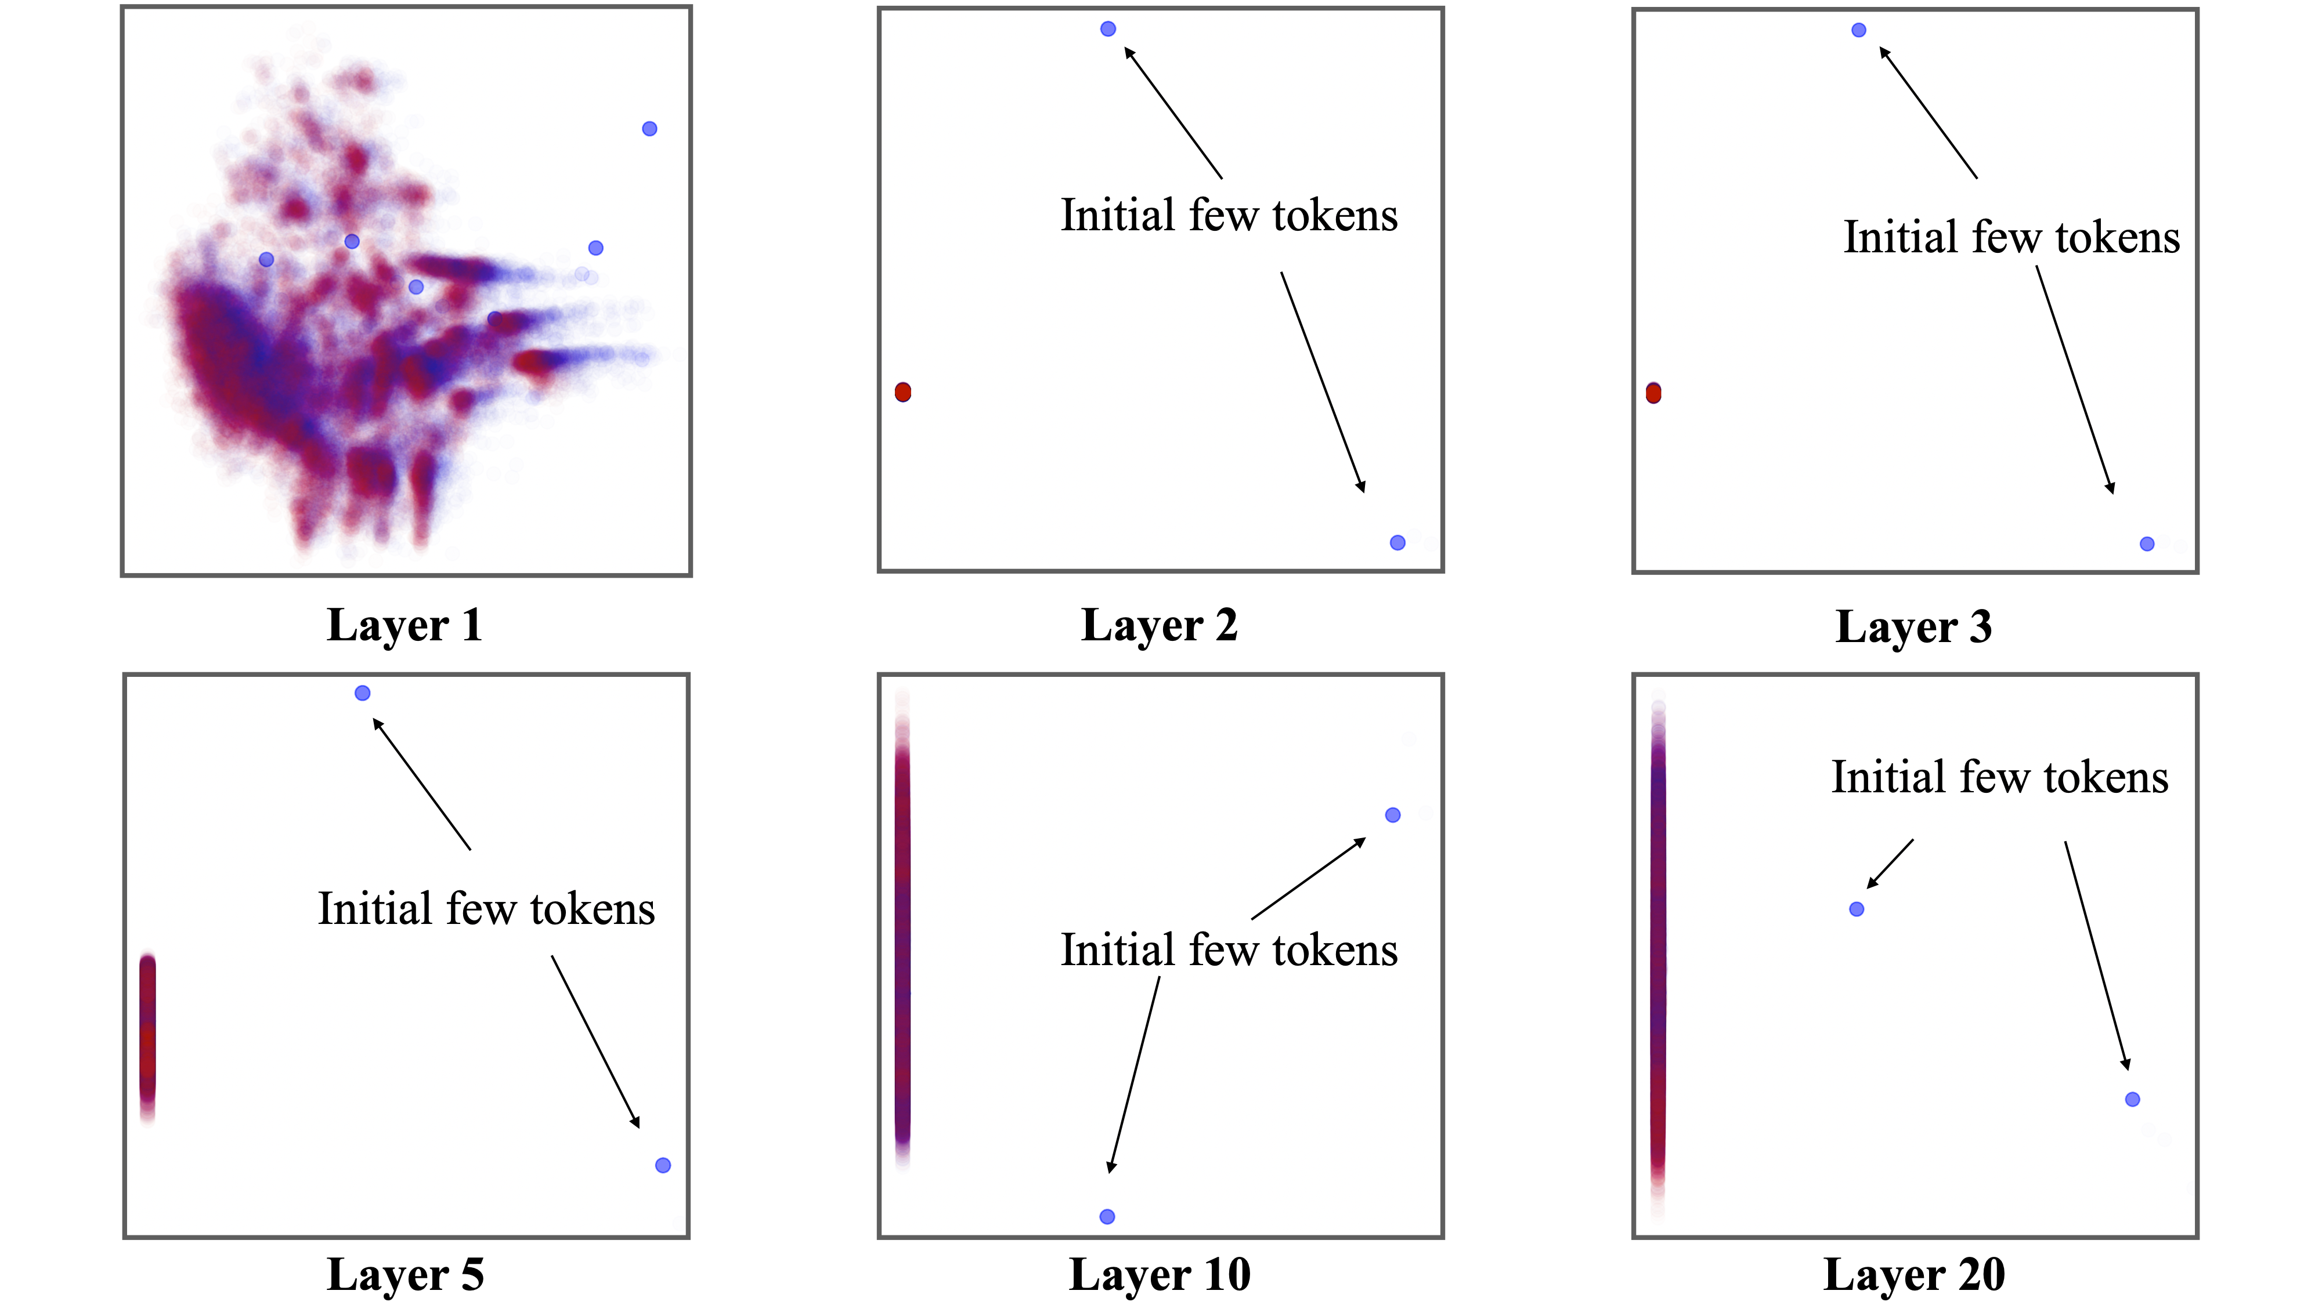
Factor 3: Implicitly Encoded Position
Part 2: Physiology - Topic 1: Attention
From layer 2 and higher, initial few tokens occupy a distinct feature space.
Theorem 3 (Informal): Even without absolute positional embeddings, attention can restore position information of tokens.
Kazemnejad, Amirhossein, et al. "The impact of positional encoding on length generalization in transformers." Advances in Neural Information Processing Systems 36 (2023): 24892-24928.
Han, Chi, et al. "LM-Infinite: Zero-Shot Extreme Length Generalization for Large Language Models." Proceedings of the 2024 Conference of the North American Chapter of the Association for Computational Linguistics: Human Language Technologies (Volume 1: Long Papers). 2024. (Outstanding Paper Award)

Slide 54
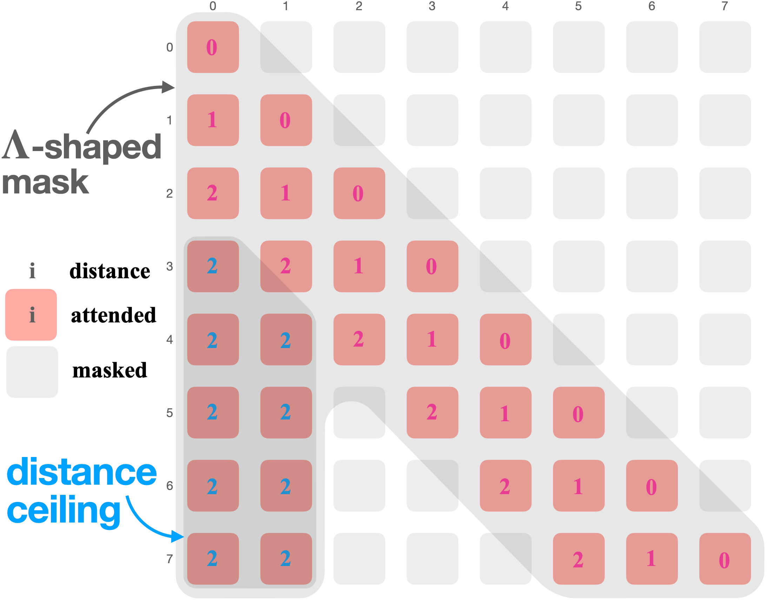
Solution: LM-Infinite
Part 2: Physiology - Topic 1: Attention
Han, Chi, et al. "LM-Infinite: Zero-Shot Extreme Length Generalization for Large Language Models." Proceedings of the 2024 Conference of the North American Chapter of the Association for Computational Linguistics: Human Language Technologies (Volume 1: Long Papers). 2024. (Outstanding Paper Award)

Slide 55
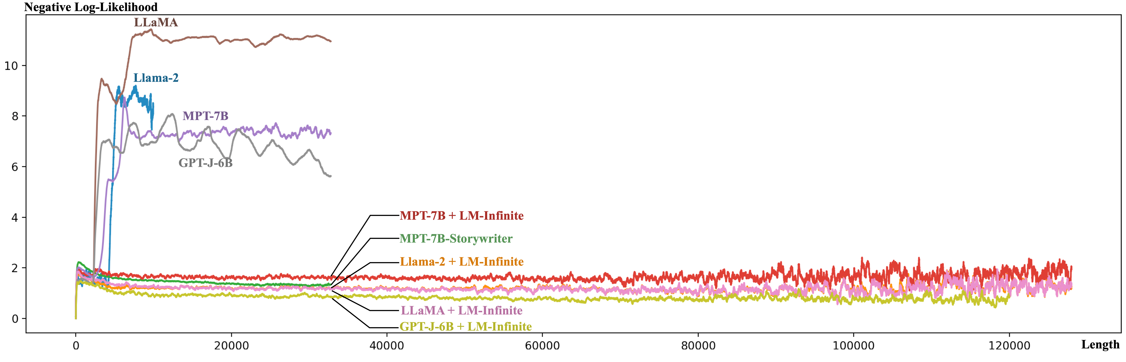
Length Generalization (to 200M length)
Part 2: Physiology - Topic 1: Attention
Han, Chi, et al. "LM-Infinite: Zero-Shot Extreme Length Generalization for Large Language Models." Proceedings of the 2024 Conference of the North American Chapter of the Association for Computational Linguistics: Human Language Technologies (Volume 1: Long Papers). 2024. (Outstanding Paper Award)

Slide 56
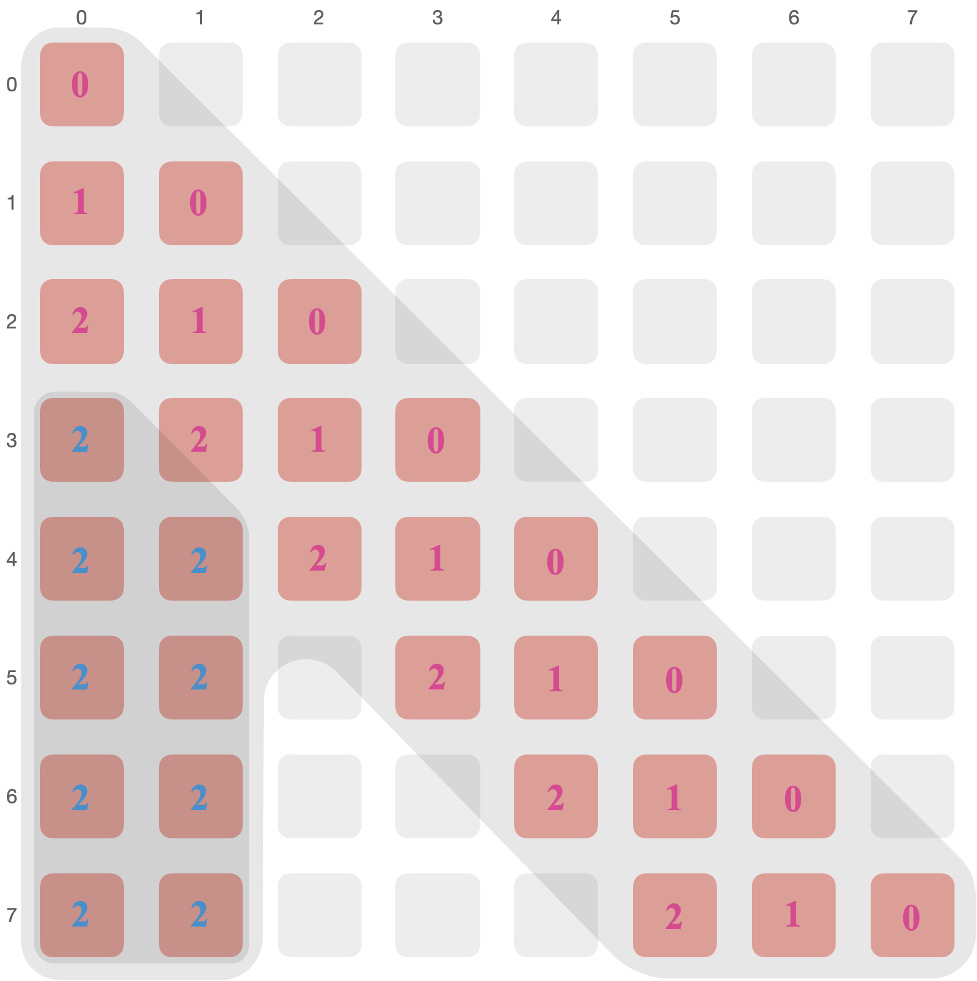
To Perceive Sensitive Information
Part 2: Physiology - Topic 1: Attention
Re-attending to top-k attention tokens
Why: to acquire key information that might be stored in the middle “ignored” region again.
How: selecting tokens with top-k (e.g., k=4) attention logits, and reintroducing them into attention.
When: when solving information sensitive tasks like question answering, retrieving information from documents, etc.
e.g. 1st large attention

Slide 57
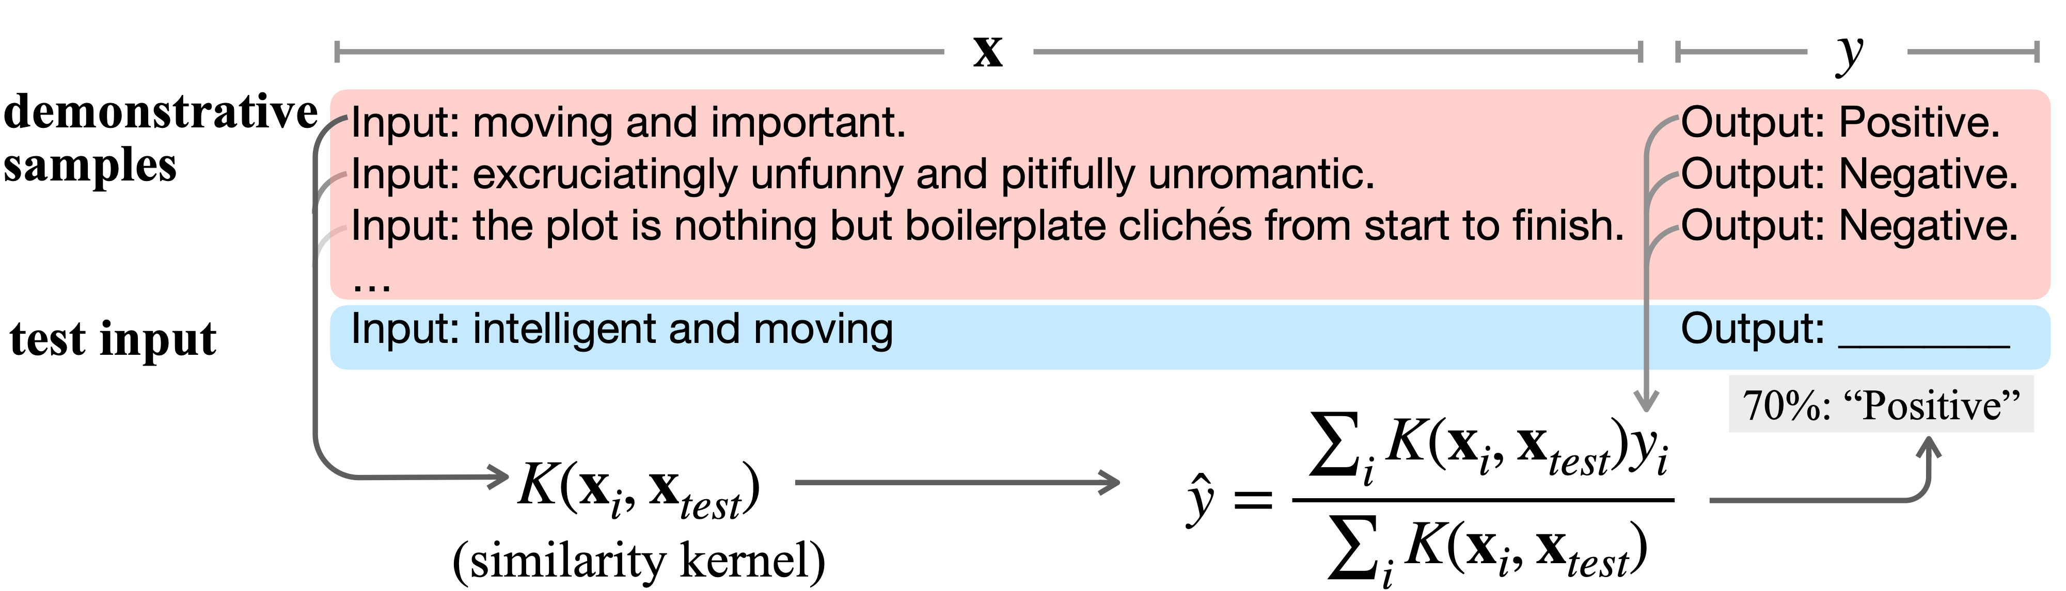
Attention Also Explains In-Context Learning
Part 2: Physiology - Topic 1: Attention
In-context learning: completing tasks based on demonstrations
Han, Chi, et al. "Explaining emergent in-context learning as kernel regression." arXiv preprint arXiv:2305.12766 (2023).

Slide 58
Attention Also Explains In-Context Learning
Part 2: Physiology - Topic 1: Attention
The output $\overset{̂}{y}$ is sampled from a weighted average over example outputs $y_{i}$ (i.e., a kernel-regression)
the weights are computed by a certain similarity metric $K(x_{i},x_{text})$ (i.e., a kernel)
Han, Chi, et al. "Explaining emergent in-context learning as kernel regression." arXiv preprint arXiv:2305.12766 (2023).

Slide 59
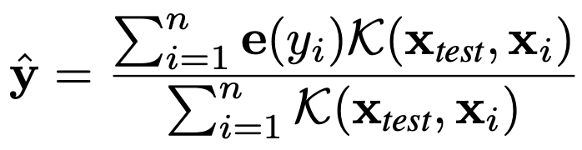
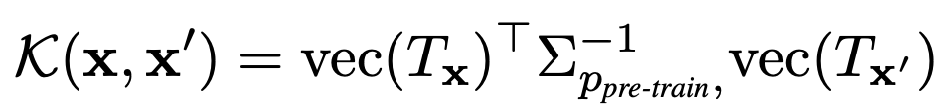
The Kernel Originates from Pre-Training
Part 2: Physiology - Topic 1: Attention
Kernel regression (hypothesized ICL algorithm)
The kernel (similarity metric)
A representation of sample input $x$ for predicting the next token
A matrix about the pre-training objective
Han, Chi, et al. "Explaining emergent in-context learning as kernel regression." arXiv preprint arXiv:2305.12766 (2023).

Slide 60
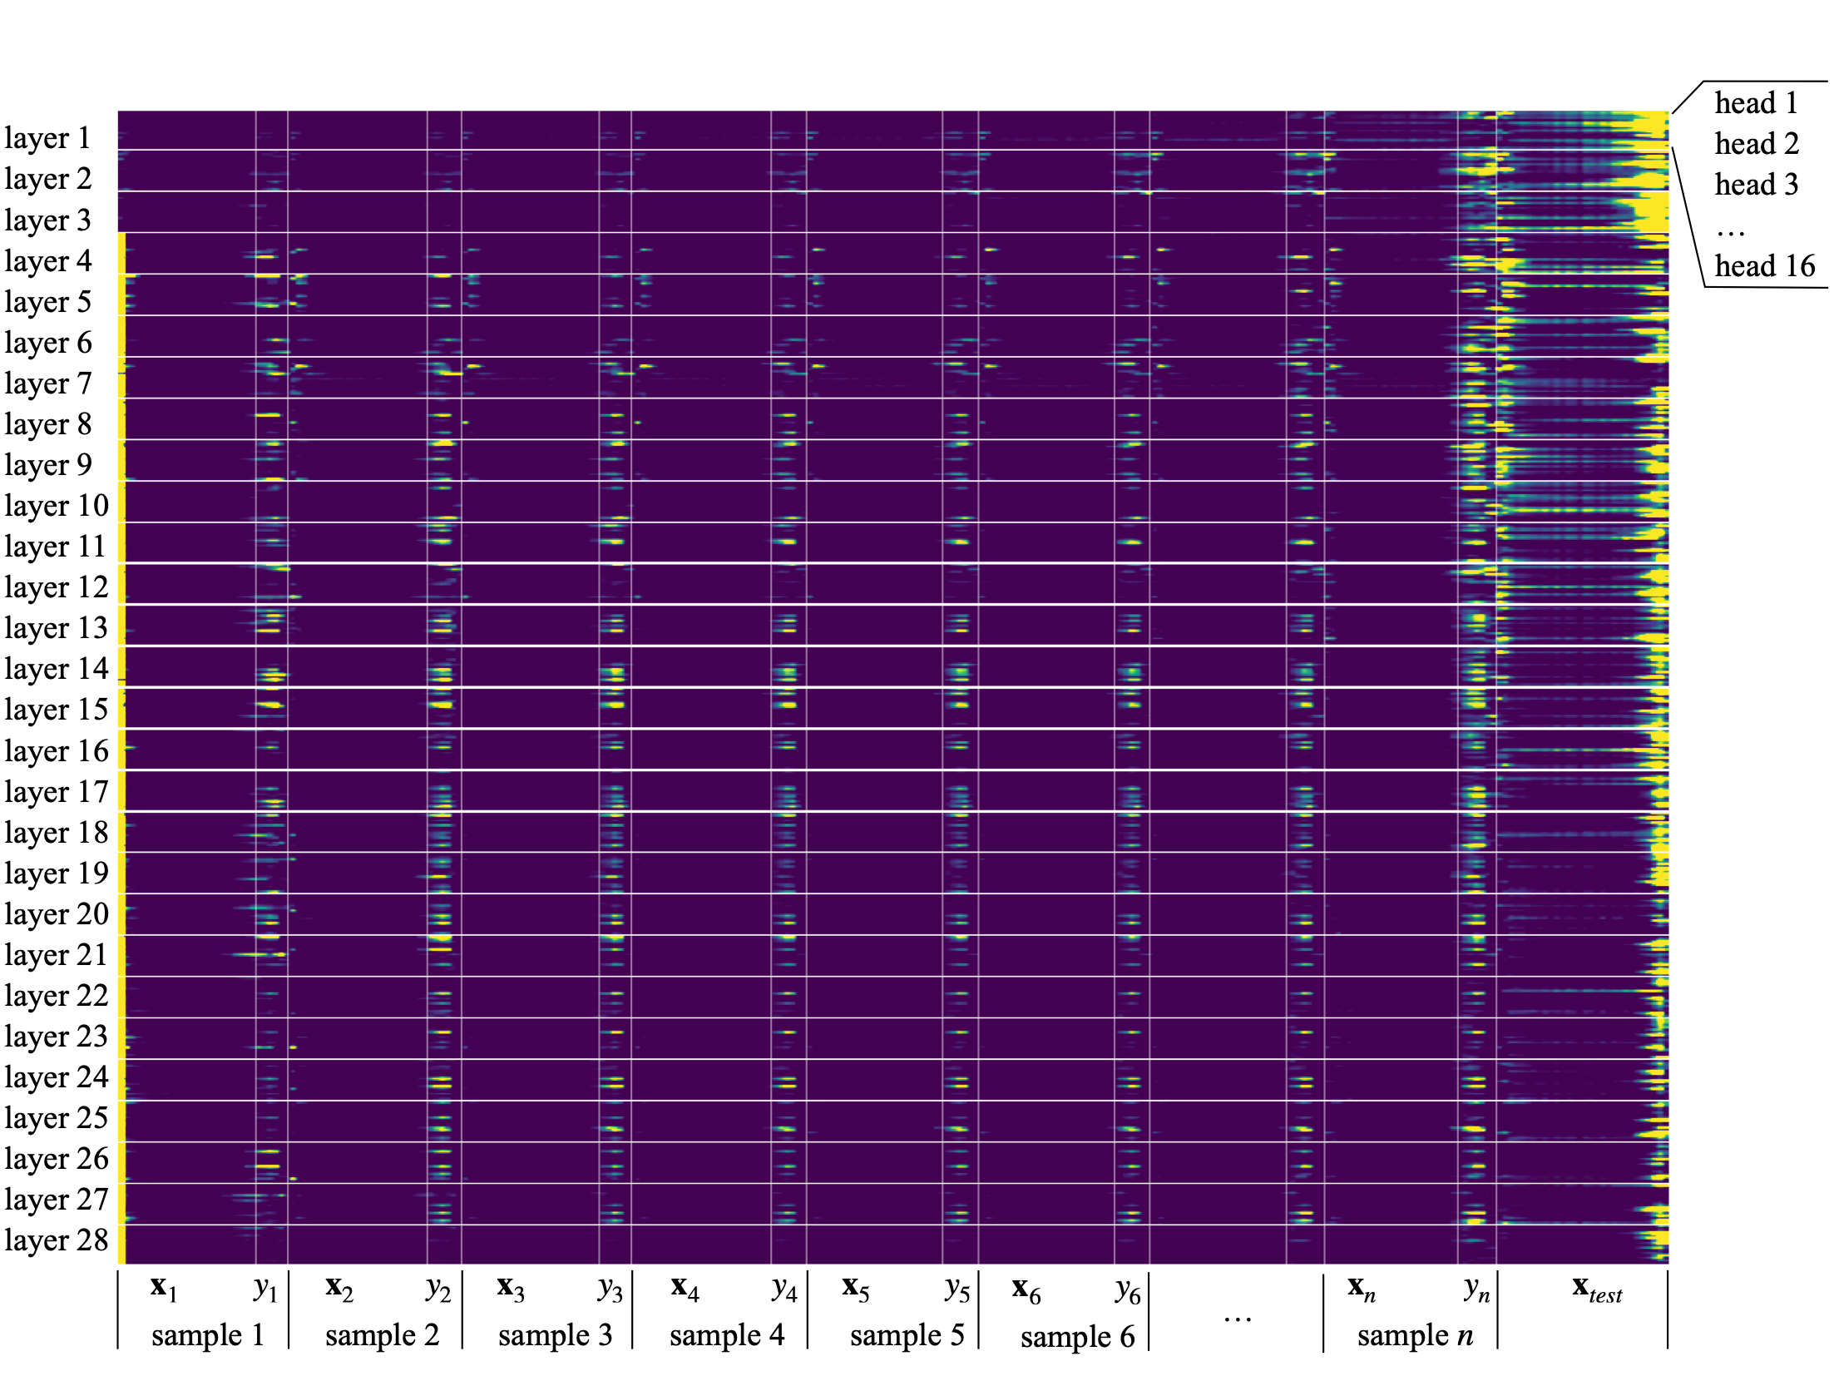
The Attention Applies to $y_{i}$ As Kernel Regression
Part 2: Physiology - Topic 1: Attention
Han, Chi, et al. "Explaining emergent in-context learning as kernel regression." arXiv preprint arXiv:2305.12766 (2023).

Slide 61
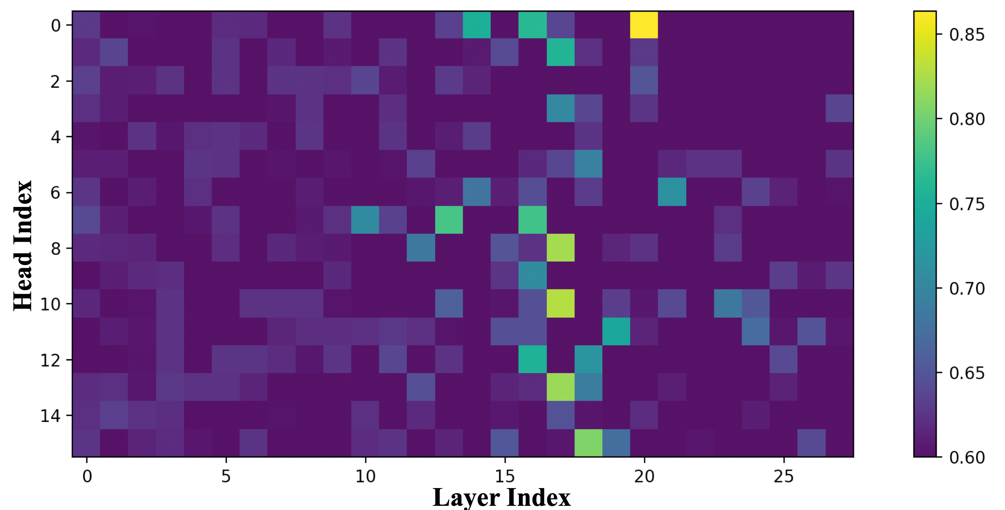
The Explanation Aligns With the Model Output
Part 2: Physiology - Topic 1: Attention
Certain attention heads can reconstruct the LLM ICL output with the explanation.
Han, Chi, et al. "Explaining emergent in-context learning as kernel regression." arXiv preprint arXiv:2305.12766 (2023).

Slide 62
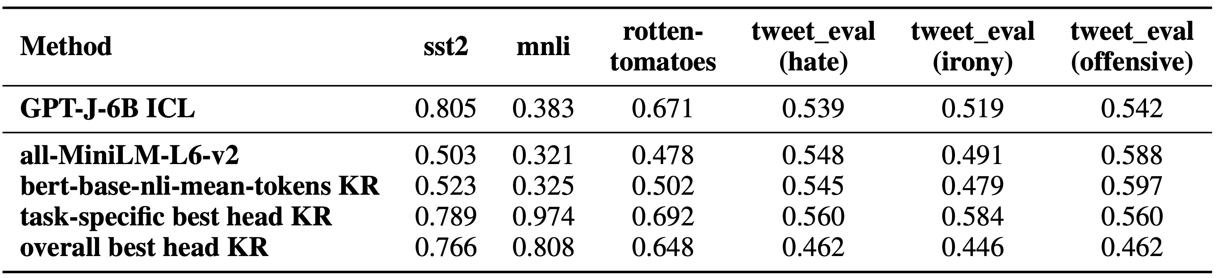
The Attention
Part 2: Physiology - Topic 1: Attention
The KR explanation explained most tasks well (except for MNLI)
KR based on baseline sentence embeddings models
Han, Chi, et al. "Explaining emergent in-context learning as kernel regression." arXiv preprint arXiv:2305.12766 (2023).

Slide 63
Room for Future Research
Part 2: Physiology - Topic 1: Attention
Attention module’s role in syntax and word order processing
More precise categorization of attention’s role in demonstration learning
Explaining and addressing and lost-in-the-middle and position bias problem

Slide 64
What Is the Function of Word Embeddings
Part 2: Physiology - Topic 2: Embedding

Slide 65
What Do Word Embeddings Embed?
Part 2: Physiology - Topic 2: Embedding
Previous papers mostly focus on word-level interpretations
(a) Analogical Relations (metric space)
Mikolov, Tomáš, Wen-tau Yih, and Geoffrey Zweig. "Linguistic regularities in continuous space word representations." Proceedings of the 2013 conference of the north american chapter of the association for computational linguistics: Human language technologies. 2013.
Bolukbasi, T., Chang, K. W., Zou, J. Y., Saligrama, V., & Kalai, A. T. (2016). Man is to computer programmer as woman is to homemaker? debiasing word embeddings. Advances in neural information processing systems, 29.

Slide 66
What Do Word Embeddings Embed?
Part 2: Physiology - Topic 2: Embedding
Previous papers mostly focus on word-level interpretations
“country” dim $→$
“Position” dim $→$
(b) Meaningful Dimensions (linear Space)
Park, Sungjoon, JinYeong Bak, and Alice Oh. "Rotated word vector representations and their interpretability." Proceedings of the 2017 Conference on Empirical Methods in Natural Language Processing. 2017.

Slide 67
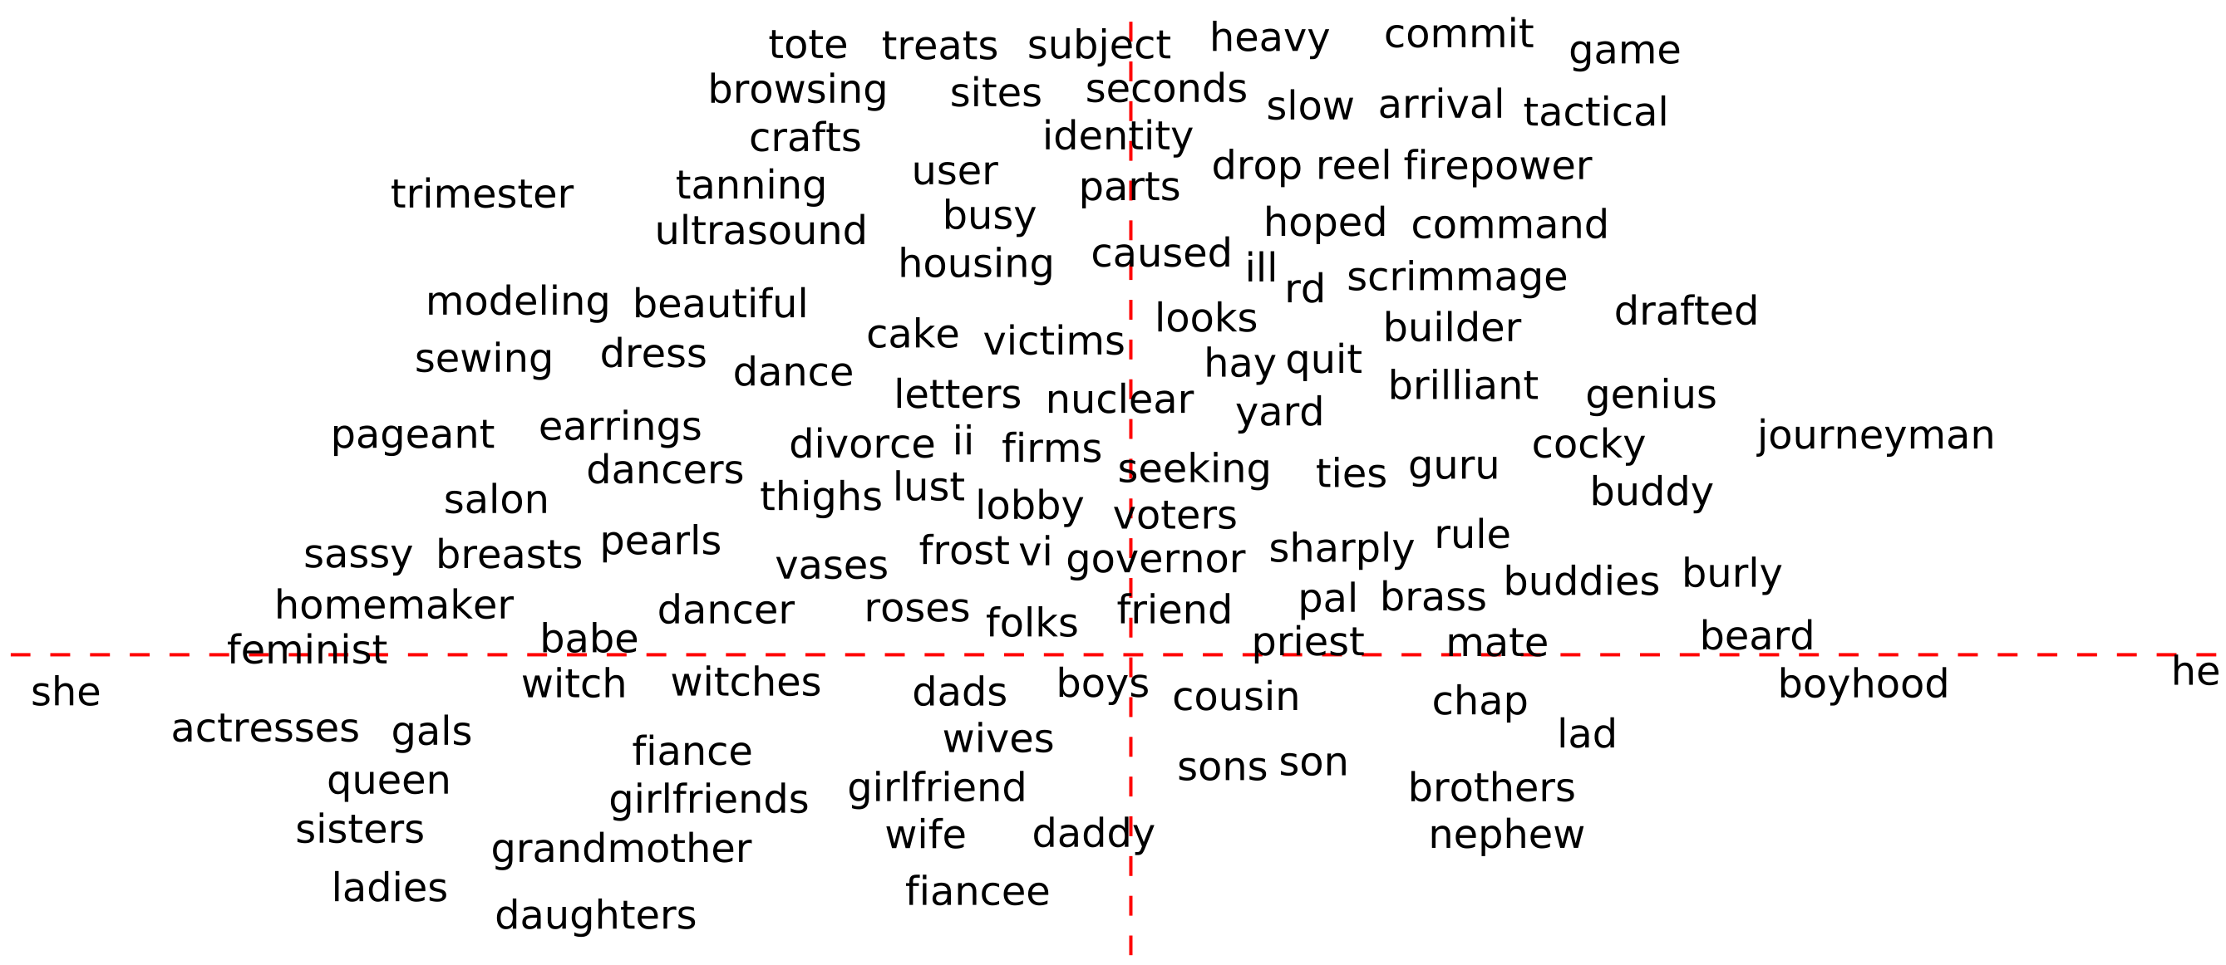
What Do Word Embeddings Embed?
Part 2: Physiology - Topic 2: Embedding
Previous papers mostly focus on word-level interpretations
gender neutral
gender-related
(b) Meaningful Dimensions (linear Space)
Bolukbasi, T., Chang, K. W., Zou, J. Y., Saligrama, V., & Kalai, A. T. (2016). Man is to computer programmer as woman is to homemaker? debiasing word embeddings. Advances in neural information processing systems, 29.

Slide 68
Word Embeddings in Causal LMs
Part 2: Physiology - Topic 2: Embedding
$$P(X_{2}|x_{1})$$
$$P(X_{3}|x_{1},x_{2})$$
Output Word Embeddings
$$⋯$$
$$(e_{1},e_{2},⋯e_{n})$$
$$=E$$
Contextual Vectors
$$c(x_{1})$$
$$c(x_{1},x_{2})$$
$$⋯$$
Causal/Generative Language Model
Input Word Embeddings
$$e_{x_{1}}^{′}$$
$$e_{x_{2}}^{′}$$
$$e_{x_{3}}^{′}$$
$$e_{x_{4}}^{′}$$
$$e_{x_{5}}^{′}$$
$$e_{x_{6}}^{′}$$
$$e_{x_{7}}^{′}$$
Text
$$x_{1}$$
$$x_{2}$$
$$x_{3}$$
$$x_{4}$$
$$x_{5}$$
$$x_{6}$$
$$x_{7}$$

Slide 69
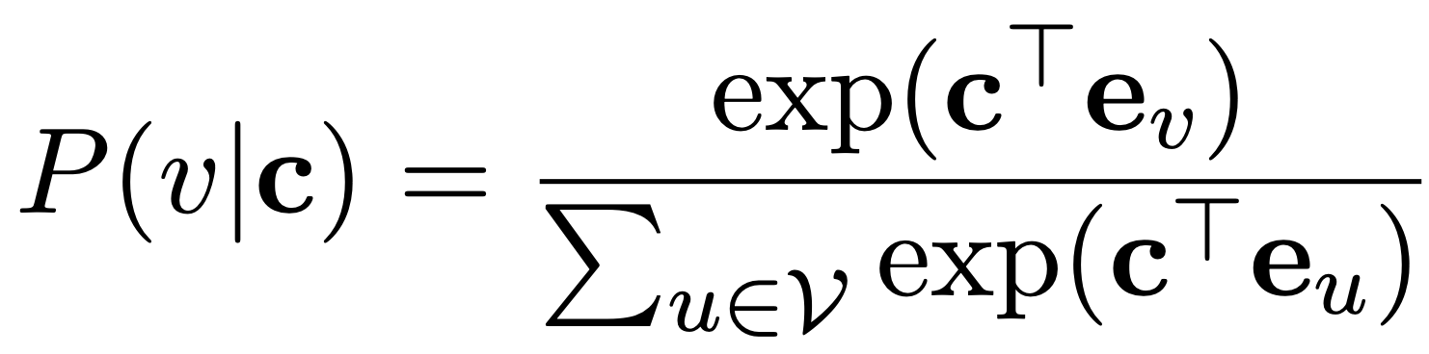
Output Word Embeddings
Part 2: Physiology - Topic 2: Embedding
Projecting to Logits
$$P(X_{i}|x_{1},⋯,x_{i-1})$$
$$(e_{1},e_{2},⋯e_{n})$$
$$=E$$
$$c(x_{1},⋯,x_{i-1})$$

Slide 70
Sequence Shift $≈$ Word Embedding Transform
Part 2: Physiology - Topic 2: Embedding
Theorem (Informal): steering between text distribution is associated with a linear transformation on word embedding space under assumptions.
$$T$$
…
state initialization changes
$$p_{init}$$
$$h_{1}$$
linear transformation
$$p_{init}^{′}$$
$$B$$
$$E$$
$$WE$$
$$e_{v}$$
…
$$v_{1}$$
equivalent to
Han, Chi, et al. "Word Embeddings Are Steers for Language Models." Proceedings of the 62nd Annual Meeting of the Association for Computational Linguistics (Volume 1: Long Papers). 2024. (Outstanding Paper Award)

Slide 71
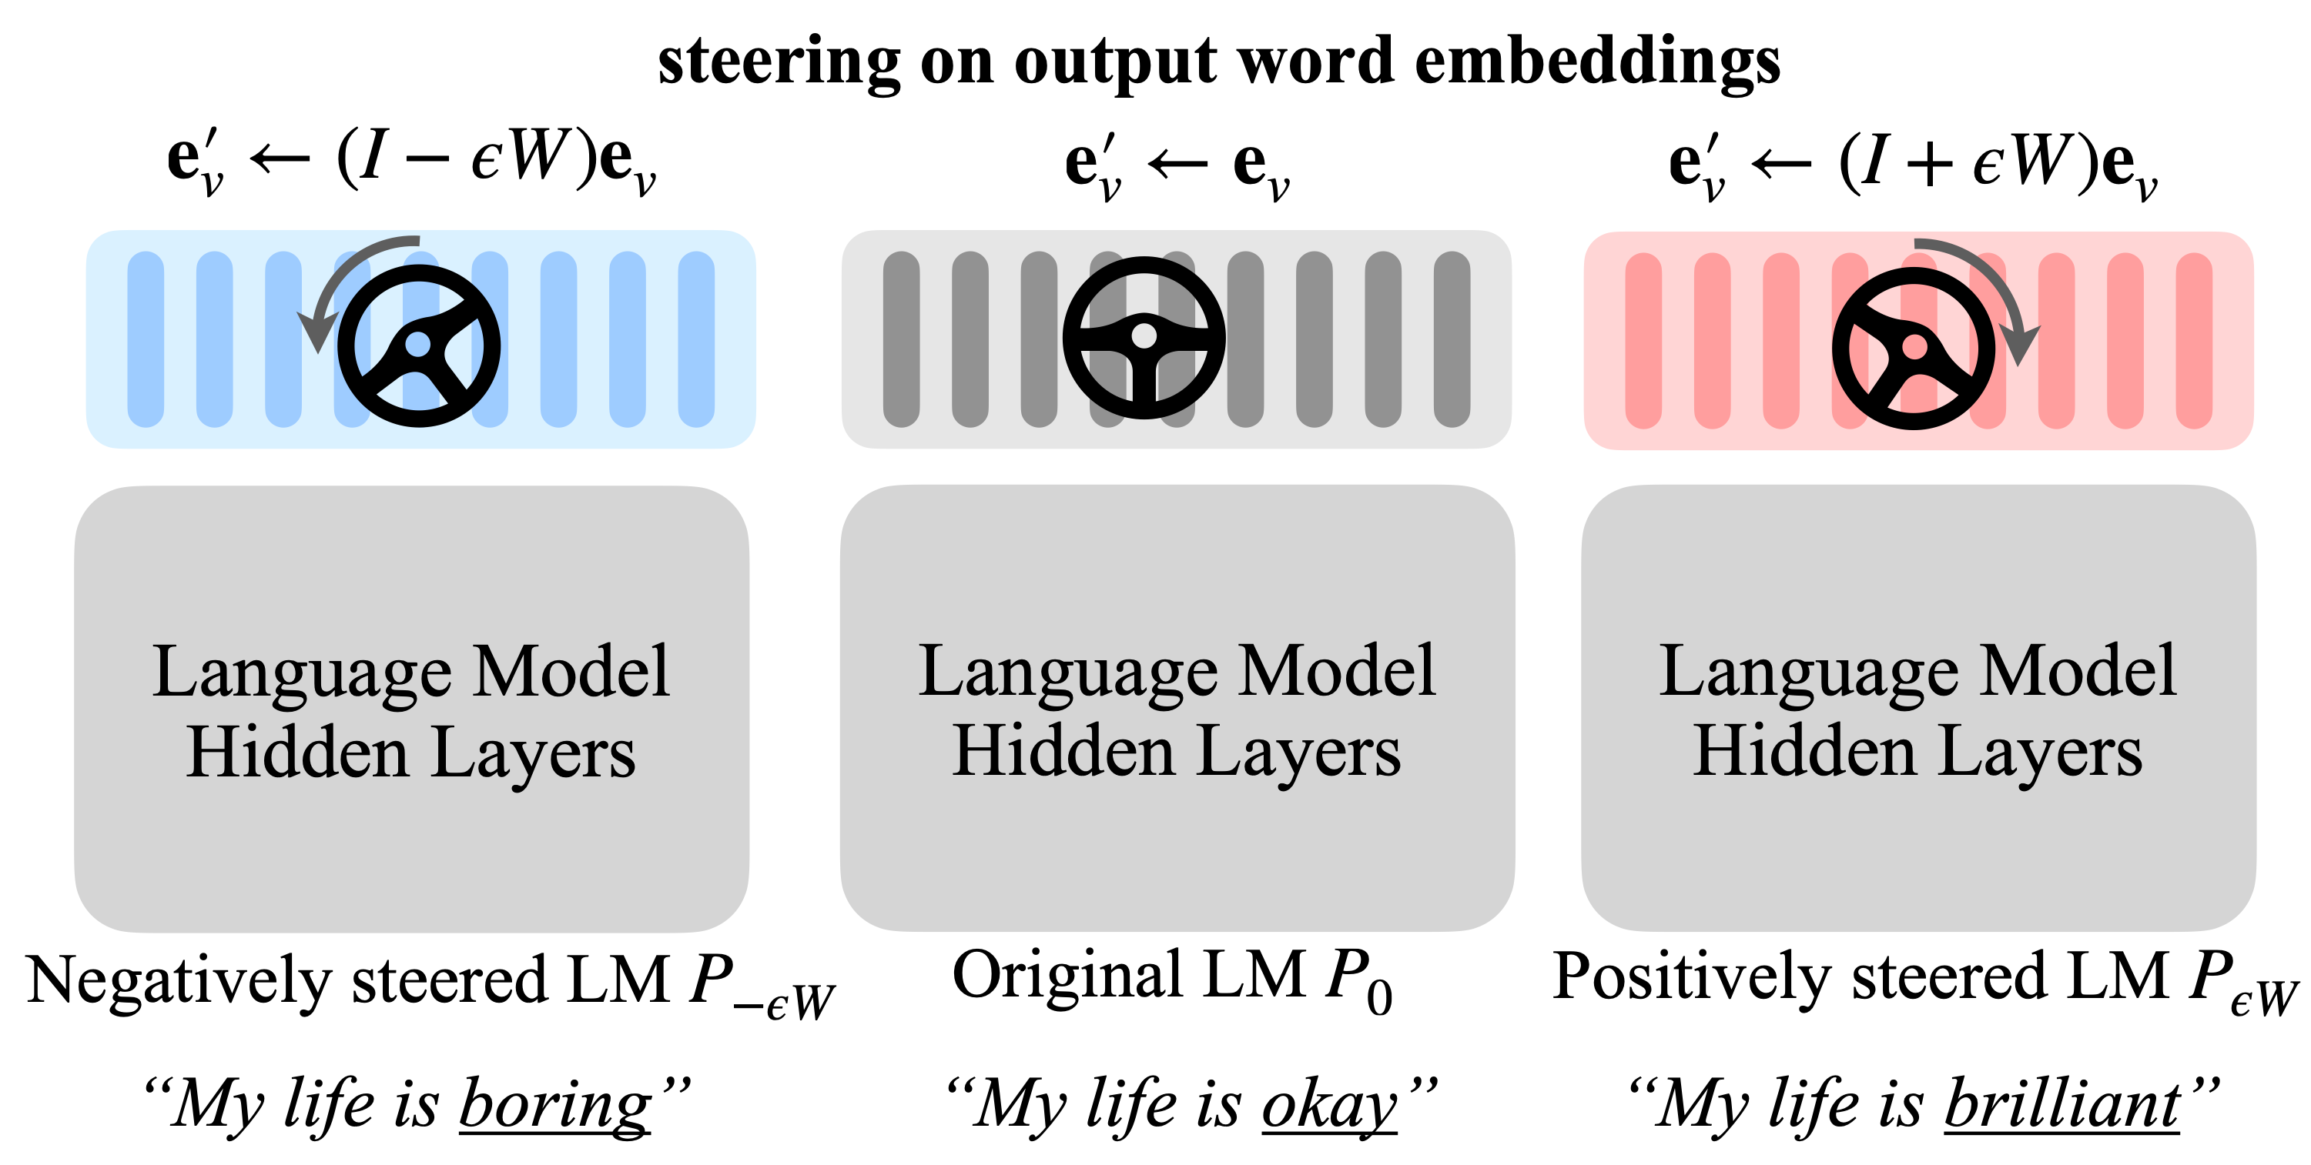
LM-Steer
Part 2: Physiology - Topic 2: Embedding
Han, Chi, et al. "Word Embeddings Are Steers for Language Models." Proceedings of the 62nd Annual Meeting of the Association for Computational Linguistics (Volume 1: Long Papers). 2024. (Outstanding Paper Award)

Slide 72
LM-Steer Broken Down
Part 2: Physiology - Topic 2: Embedding
Output word embedding $E$
for each word:$e_{v}^{′}=e_{v}+ϵWe_{v}$
$$+=ϵ⋅WE$$
$$W$$
The steering scale
the steering matrix
Language Model Hidden Layers
“ ”
“ ”
$$ϵ$$
$$W$$

Slide 73
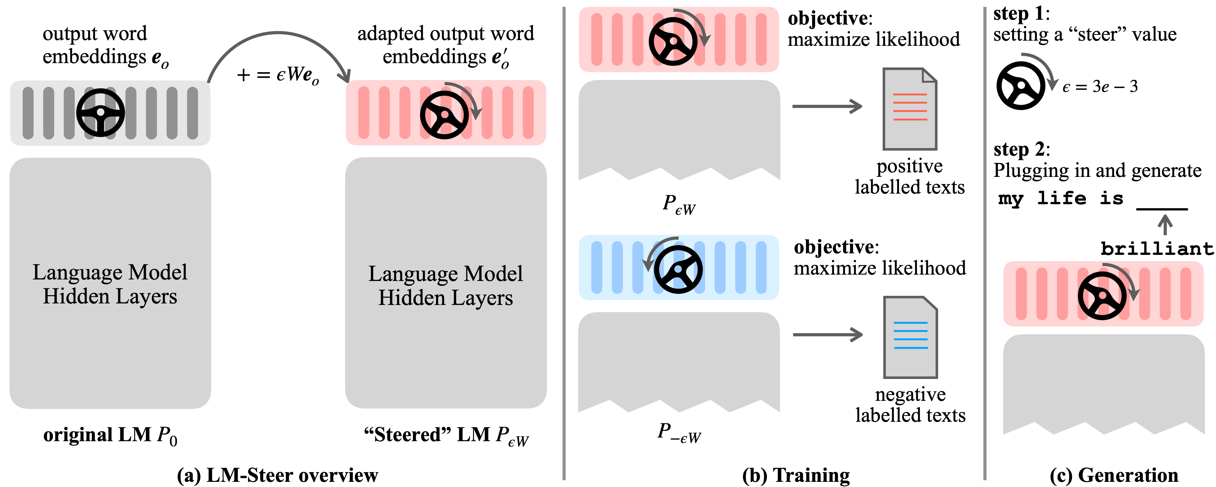
Training & Inference
Part 2: Physiology - Topic 2: Embedding
Han, Chi, et al. "Word Embeddings Are Steers for Language Models." Proceedings of the 62nd Annual Meeting of the Association for Computational Linguistics (Volume 1: Long Papers). 2024. (Outstanding Paper Award)

Slide 74
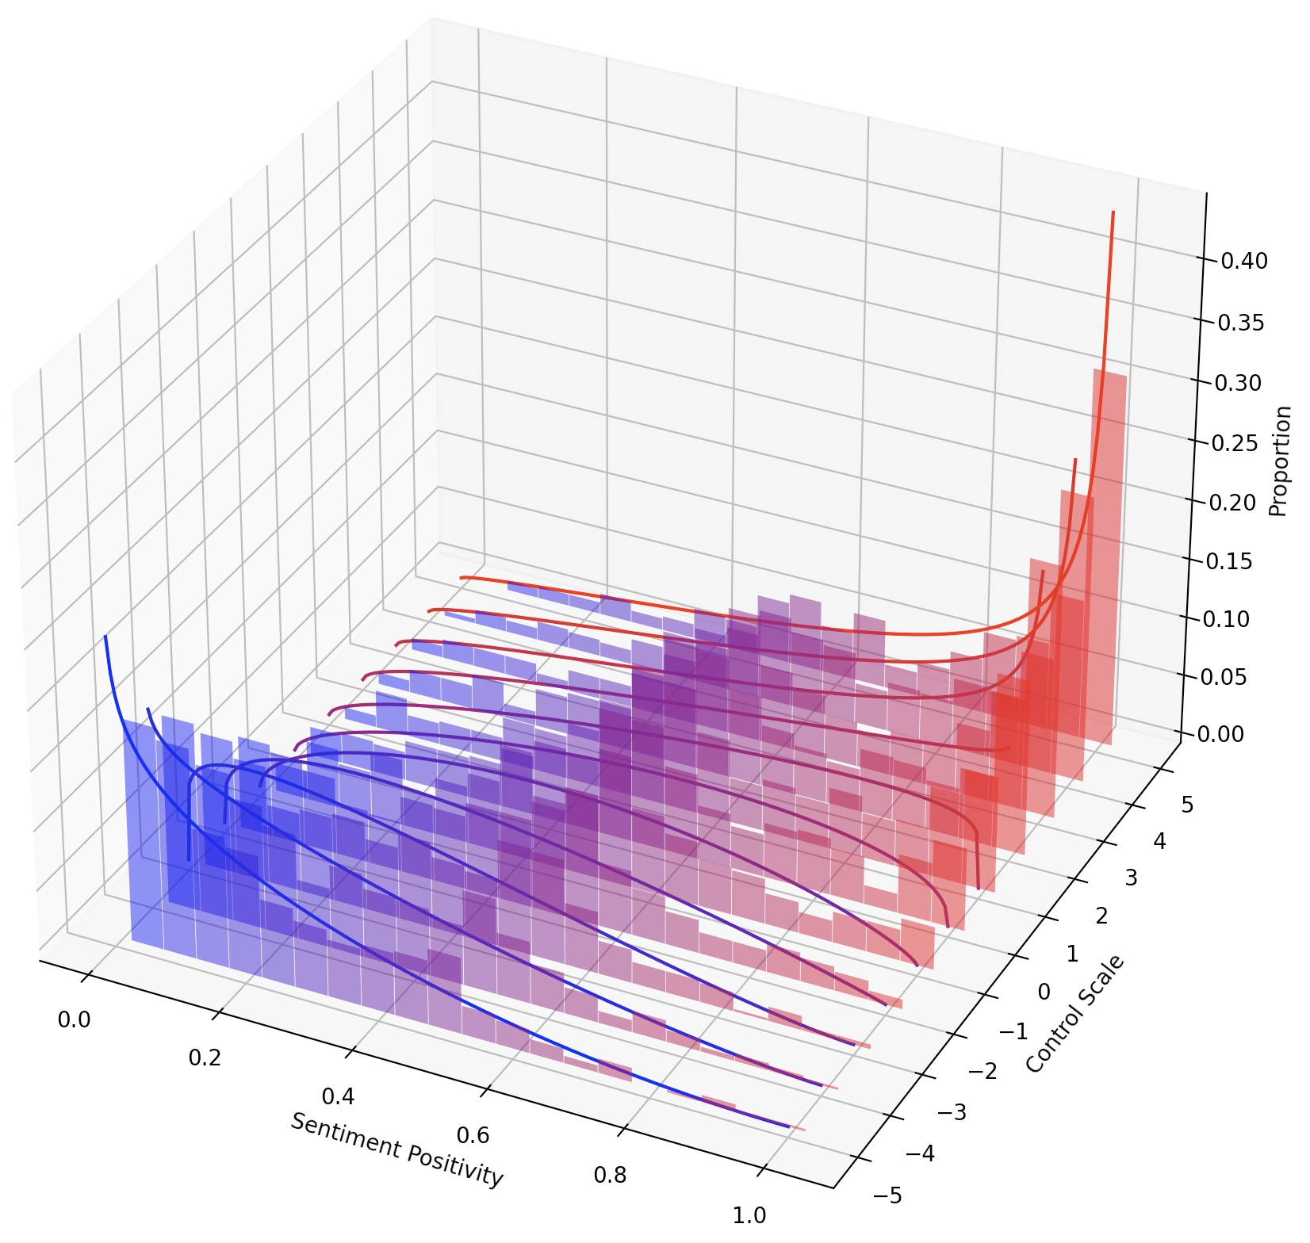
Continuous Steering
Part 2: Physiology - Topic 2: Embedding
Proportion
curves: maximal likelihood beta-distribution
Sentiment Distribution Space
$$sentiment(P_{ϵW})$$
Steer value $ϵ$
Sentiment
Han, Chi, et al. "Word Embeddings Are Steers for Language Models." Proceedings of the 62nd Annual Meeting of the Association for Computational Linguistics (Volume 1: Long Papers). 2024. (Outstanding Paper Award)

Slide 75
Compositional Steering
Part 2: Physiology - Topic 2: Embedding
LM-Steer 1: $P_{ϵ_{1}W_{1}}$
LM-Steer 2: $P_{ϵ_{2}W_{2}}$
Combined LM-Steer: $P_{ϵ_{1}W_{1}+ϵ_{2}W_{2}}$
Han, Chi, et al. "Word Embeddings Are Steers for Language Models." Proceedings of the 62nd Annual Meeting of the Association for Computational Linguistics (Volume 1: Long Papers). 2024. (Outstanding Paper Award)

Slide 76
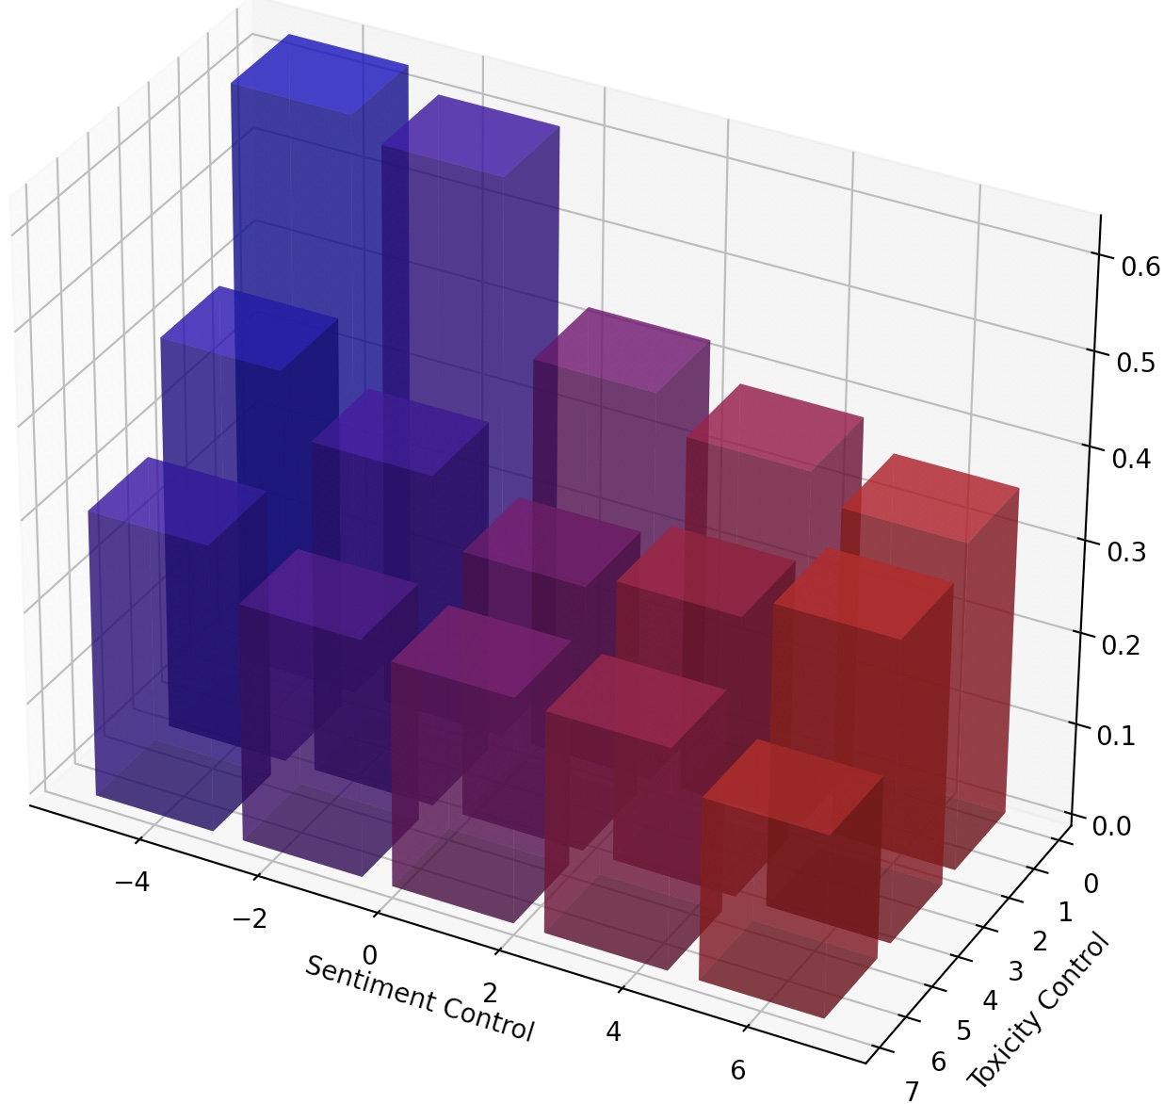
Compositional Steering
Part 2: Physiology - Topic 2: Embedding
negative sentiment
Toxicity
positive sentiment
An entanglement between steering dimensions
Toxicity control
Sentiment control

Slide 77
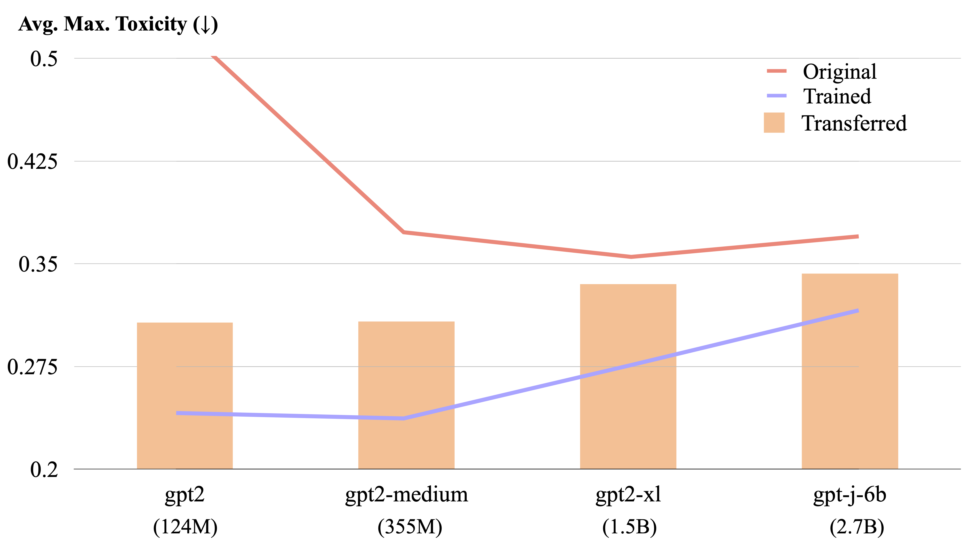
Transferring to Another LM
Part 2: Physiology - Topic 2: Embedding
transfers about half of the detoxification capability
Han, Chi, et al. "Word Embeddings Are Steers for Language Models." Proceedings of the 62nd Annual Meeting of the Association for Computational Linguistics (Volume 1: Long Papers). 2024. (Outstanding Paper Award)

Slide 78
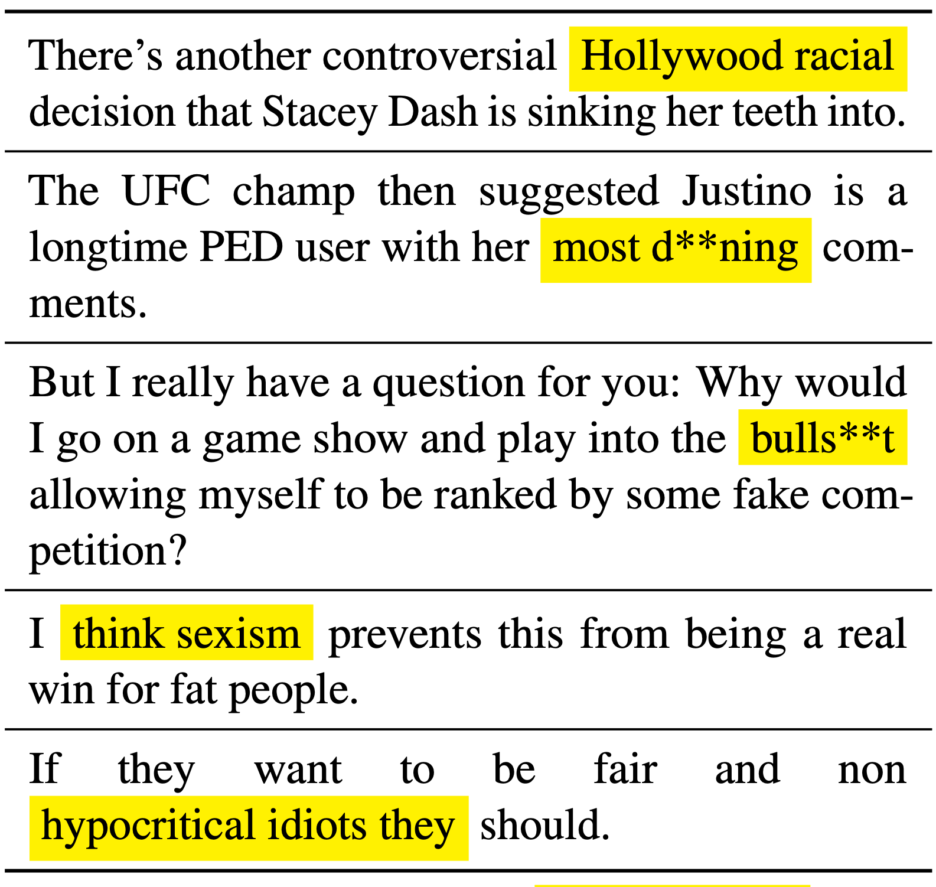
Highlighting Keywords
Part 2: Physiology - Topic 2: Embedding
Automatically highlighting text spans most related to a distribution.
Example: toxic word highlighting
Han, Chi, et al. "Word Embeddings Are Steers for Language Models." Proceedings of the 62nd Annual Meeting of the Association for Computational Linguistics (Volume 1: Long Papers). 2024. (Outstanding Paper Award)

Slide 79
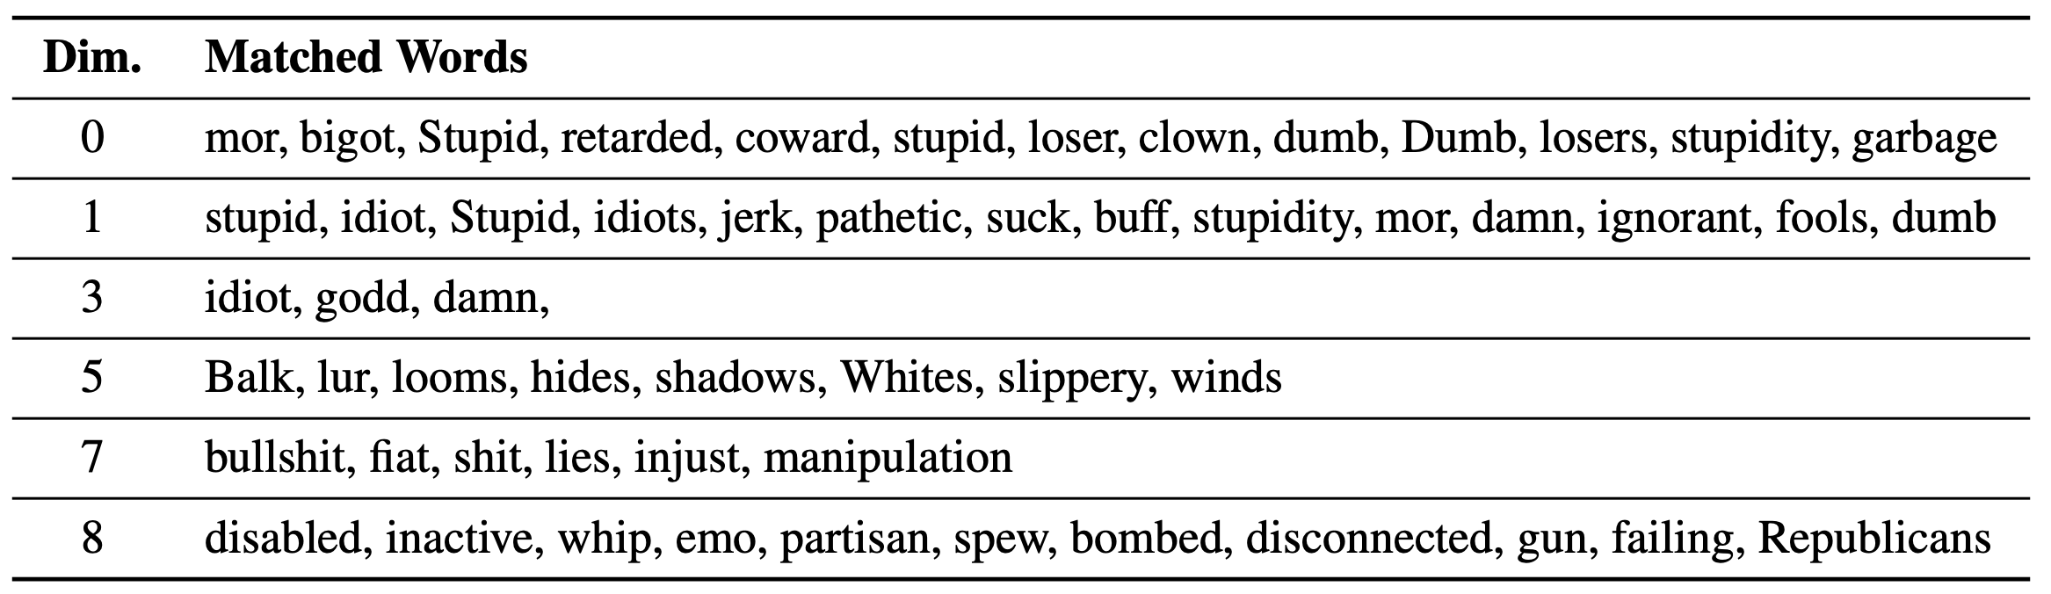
A Probe on the Word Embedding Space
Part 2: Physiology - Topic 2: Embedding
personal abuses
curses
critiques
political
(Some dimensions were omitted as they match non-English words)
Han, Chi, et al. "Word Embeddings Are Steers for Language Models." Proceedings of the 62nd Annual Meeting of the Association for Computational Linguistics (Volume 1: Long Papers). 2024. (Outstanding Paper Award)

Slide 80
Room for Future Research
Part 2: Physiology - Topic 2: Embedding
Evolution of contextual embeddings across layers, e.g., how ambiguity is resolved in LMs
Better frameworks for studying the role of word embeddings
Other functions of word embeddings, such as semantics and sense

Slide 81
Rules and Laws of LMs
Part 3: Physics
Topics
Scaling: How performance scales
Impossibilities: What LMs cannot do fundamentally

Slide 82
Scaling: How Performance Scales
Part 3: Physics - Topic 1: Scaling Laws

Slide 83
General Principle
Part 3: Physics - Topic 1: Scaling Laws
Inducing rules from simplified and controlled experiments (similar to early ages of physics).
https://en.wikipedia.org/wiki/File:Galileolarge.png

Slide 84
Scaling Laws
Part 3: Physics - Topic 1: Scaling Laws
Is Model Performance Predictable?
In physics:
In LMs:
Observation: larger force + smaller weight $→$ moving faster
Observation: larger model + more data $→$ higher score
Newton’s Law:
$$F=ma$$
Any law to predict scores before training?

Slide 85
Why Do We Need Scaling Laws?
Part 3: Physics - Topic 1: Scaling Laws
Curiosity
Early debugging
Better allocation of the resources
score
cost requirement to achieve a certain score
predicted
actual
something wrong here!
time

Slide 86


Law on Data Size Seen During Training
Part 3: Physics - Topic 1: Scaling Laws
$D$: Trained tokens in training
Kaplan, Jared, Sam McCandlish, Tom Henighan, Tom B. Brown, Benjamin Chess, Rewon Child, Scott Gray, Alec Radford, Jeffrey Wu, and Dario Amodei. "Scaling laws for neural language models." arXiv preprint arXiv:2001.08361 (2020).

Slide 87


Law on Model Size
Part 3: Physics - Topic 1: Scaling Laws
w/ embeddings: harder to fit
w/o embeddings: neater trend
Message: word embeddings and other parameters have different effects when scaling.
$N$: model size
Kaplan, Jared, Sam McCandlish, Tom Henighan, Tom B. Brown, Benjamin Chess, Rewon Child, Scott Gray, Alec Radford, Jeffrey Wu, and Dario Amodei. "Scaling laws for neural language models." arXiv preprint arXiv:2001.08361 (2020).

Slide 88

Architecture Also Matters
Part 3: Physics - Topic 1: Scaling Laws
Kaplan, Jared, Sam McCandlish, Tom Henighan, Tom B. Brown, Benjamin Chess, Rewon Child, Scott Gray, Alec Radford, Jeffrey Wu, and Dario Amodei. "Scaling laws for neural language models." arXiv preprint arXiv:2001.08361 (2020).

Slide 89

Can Laws Be Unified?
Part 3: Physics - Topic 1: Scaling Laws
$D$: Data Size FLOPs $≈6ND$
$$L(N,D)$$
$$L(N,D)=E+\frac{A}{N^{α}}+\frac{B}{D^{β}}$$
$$N$$
Hoffmann, Jordan, et al. "Training compute-optimal large language models." arXiv preprint arXiv:2203.15556 (2022).

Slide 90

Optimal Resource Allocation by Laws
Part 3: Physics - Topic 1: Scaling Laws
IsoLoss contour: lines where $L(N,D)$ is the same
The contours enable us to find minimal FLOP for each loss value
Hoffmann, Jordan, et al. "Training compute-optimal large language models." arXiv preprint arXiv:2203.15556 (2022).

Slide 91


Chinchilla’s Law for Model and Data Size
Part 3: Physics - Topic 1: Scaling Laws
Chinchilla
Kaplan
Scaling ratio = $α/β≈1:1$
Scaling ratio = $α_{N}/α_{D}≈3:1$
Hoffmann, Jordan, et al. "Training compute-optimal large language models." arXiv preprint arXiv:2203.15556 (2022).

Slide 92

The Knowledge Capacity Scaling Law
Part 3: Physics - Topic 1: Scaling Laws
Under ideal conditions, LMs store 2 bits of knowledge / parameter.
Allen-Zhu, Zeyuan, and Yuanzhi Li. "Physics of Language Models: Part 3.3, Knowledge Capacity Scaling Laws." The Thirteenth International Conference on Learning Representations.

Slide 93
Factors in Knowledge Storage
Part 3: Physics - Topic 1: Scaling Laws
More exposure in training helps
MLP improves capacity
Mild quantization is okay
Low-quality data hurts storage ratio
Allen-Zhu, Zeyuan, and Yuanzhi Li. "Physics of Language Models: Part 3.3, Knowledge Capacity Scaling Laws." The Thirteenth International Conference on Learning Representations.

Slide 94

Downstream Performance Scales with Training Compute
Part 3: Physics - Topic 1: Scaling Laws
different model sizes (N)
$$Acc=\frac{a}{1+exp\left(-k(AN^{-α}+BD^{-β}+E)\right)}+b$$
Observation: scaling law contains more parameters
Potential Cause: non-linearity nature of metric functions^{[Schaeffer, et al.]}
Chen, Yangyi, et al. "Scaling laws for predicting downstream performance in LLMs." arXiv preprint arXiv:2410.08527 (2024).
Schaeffer, Rylan, Brando Miranda, and Sanmi Koyejo. "Are emergent abilities of large language models a mirage?." Advances in Neural Information Processing Systems 36 (2023): 55565-55581.
Notes:
The chinchilla scaling law describes the relationship between model size, data size and language modeling loss. Directly predicting downstream performance is not feasible due to the presence of emergence (the transition point is unpredictable and the performance increases drastically after the transition point). To circumvent this, we need to find an intermediate loss metric that follows the Chinchilla scaling law and then map this intermediate loss to the target metric that we care about.

Slide 95
Future & Active Areas for Exploration
Part 3: Physics - Topic 1: Scaling Laws
Does a unified law exist for all factors (i.e., how they interact )?
What causes these laws and the constants?
Scaling laws for/including other factors, like tokenizer, training precision, context length, data quality, composition, and diversity?
Scaling law for different model architectures (e.g., MoE, non-Transformer models, etc.)

Slide 96
What LMs Cannot Do Fundamentally
Part 3: Physics - Topic 2: Impossibilities

Slide 97
Realistic Alignment Is Always Attackable
Part 3: Physics - Topic 2: Impossibilities
Assumption: LM models a mixture of ill- and well-behaved components, and they are distinguishable
Theorem 1: With a long enough adversarial prompt, the ill behavior can be prompted from the LM.
Theorem 2: Even in the presence of a safety system prompt, it is possible to prompt the LLM into the ill behavior with a long enough appending prompt.
(disclaimer: simplified claims)
Wolf, Yotam, et al. "Fundamental Limitations of Alignment in Large Language Models." Forty-first International Conference on Machine Learning.

Slide 98

Realistic Alignment Is Always Attackable
Part 3: Physics - Topic 2: Impossibilities
Wolf, Yotam, et al. "Fundamental Limitations of Alignment in Large Language Models." Forty-first International Conference on Machine Learning.

Slide 99
Calibrated Language Models Must Hallucinate
Part 3: Physics - Topic 2: Impossibilities
Assumption: LM is well-calibrated on a finite training corpus, and sufficiently large training data, and if number of possible hallucinations greatly outweigh facts
Theorem: when the assumptions above hold, the LM is doomed to hallucinate.
(disclaimer: simplified claims)
Kalai, Adam Tauman, and Santosh S. Vempala. "Calibrated language models must hallucinate." Proceedings of the 56th Annual ACM Symposium on Theory of Computing. 2024.

Slide 100

Calibrated Language Models Must Hallucinate
Part 3: Physics - Topic 2: Impossibilities
before alignment, LM is calibrated
alignment sacrifices calibration
Achiam, Josh, et al. "Gpt-4 technical report." arXiv preprint arXiv:2303.08774 (2023).

Slide 101
“Hallucination is inevitable”
Part 3: Physics - Topic 2: Impossibilities
Assumption: hallucination is defined as inconsistencies between a computable LLM and a ground truth function in (any) world.
Theorem: Even if LLMs learn computable functions, they will inevitably hallucinate due to infinitely possible worlds.
(disclaimer: simplified claims)
Xu, Ziwei, Sanjay Jain, and Mohan Kankanhalli. "Hallucination is inevitable: An innate limitation of large language models." arXiv preprint arXiv:2401.11817 (2024).

Slide 102
Strong Watermarking Is Impossible for LMs
Part 3: Physics - Topic 2: Impossibilities
Definitions Watermark: a set of outputs $\{y|D(y)=1\}$ detectable by $D$ Strong watermarking: for any prompt $x$, and a (watermarked) output $y$, there is no efficient attacker to obtain $y^{′}$ without watermark that the $LM(x,y^{′})≥LM(x,y)$.
Theorem: with a perturbation oracle, a strong watermarking is impossible. i.e., there always exists an efficient attacker $f:y→y^{′}$
(disclaimer: simplified claims)
Zhang, Hanlin, et al. "Watermarks in the sand: impossibility of strong watermarking for language models." Forty-first International Conference on Machine Learning. 2024.

Slide 103


Strong Watermarking Is Impossible for LMs
Part 3: Physics - Topic 2: Impossibilities
detection score decreases
proposed attack algorithm by rejection sampling
GPT-4 score (quality) remains stable
Zhang, Hanlin, et al. "Watermarks in the sand: impossibility of strong watermarking for language models." Forty-first International Conference on Machine Learning. 2024.

Slide 104

Strong Watermarking Is Impossible for LMs
Part 3: Physics - Topic 2: Impossibilities
during sampling, the text is less detectable but quality remains
Zhang, Hanlin, et al. "Watermarks in the sand: impossibility of strong watermarking for language models." Forty-first International Conference on Machine Learning. 2024.

Slide 105

Strong Watermarking Is Impossible for LMs
Part 3: Physics - Topic 2: Impossibilities
4e-15
0.24
1e-5
0.47
p-value: (lower = deeper watermark)
Zhang, Hanlin, et al. "Watermarks in the sand: impossibility of strong watermarking for language models." Forty-first International Conference on Machine Learning. 2024.
Fernandez, P., Couairon, G., J´ egou, H., Douze, M., and Furon, T. The stable signature: Rooting watermarks in latent diffusion models. arXiv preprint arXiv:2303.15435, 2023.
Mountain, S. Invisible watermark, 2021. URL https://github.com/ShieldMnt/invisible-watermark#supported-algorithms.

Slide 106
Strong Watermarking Is Impossible for LMs
Part 3: Physics - Topic 2: Impossibilities
More natural settings and more realistic assumptions
Obtaining tighter bounds for LM limitations
Involving and unifying the effect of model architectures, data distribution and linguistic structure?

Slide 107
A Retrospect of Science of LMs
Model-Oriented Behavior-Oriented
Physics of LMs (laws at population level)
Performance: (Task-level scores)
Physiology of LMs (components-level)
Ethology (Instance level, behaviors)
?

Slide 108
Model-Data-Task Triangular: A Roadmap
Model
The 1.5hr tutorial is far from being comprehensive!
LM architecture design
2.1 - attention
“Physiology”
2.2 - embedding
3.1 scaling laws
“Physics”
1.1 - syntax (language structure)
1.2 - knowledge (LM & world)
1.3 - reasoning (LM capabilities)
LM theory
3.2 impossibility results
“Ethology”
performance improvement
Data
data collection
Task

Slide 109
Discussions and Q&A
Will we have a unified scientific framework for analyzing LMs? or, multiple levels of frameworks instead?
particles
fluid (mass of particles )
supersonic flow
$$\frac{∂u}{∂t}+(u⋅∇)u=-\frac{1}{ρ}∇ρ+ν∇^{2}u$$
shock waves, etc…
$$F=ma$$
Will we be able to characterize every phenomenon? or, will there always be a next unsolved problem, just as in curse of dimensionality
image credit: https://www.visiondummy.com/2014/04/curse-dimensionality-affect-classification/

